Slide 1
Anatomy of a Cell
Functions of a Cell [Do1]

Slide 2
Post- Discussion
What functions did animals, plants, and cells have in common?

Slide 3
Commonalities
Nutrients entering the body
Waste to leave the body
Outer layer for protection
Support structure
Source of energy
Control system

Slide 4
Discussion
Why where some functions for plants, animals, and cells different?

Slide 5
Answer
All need energy but each one has a different way of collecting and processing the energy.
Plants and animals have a support structure…….
What is different?

Slide 6
Discussion
How are cells like unicellular organisms?

Slide 7
Answer
A cell has the same life functions as plants and animals
[growth, energy collections, protection, waster removal, reproduction]

Slide 8
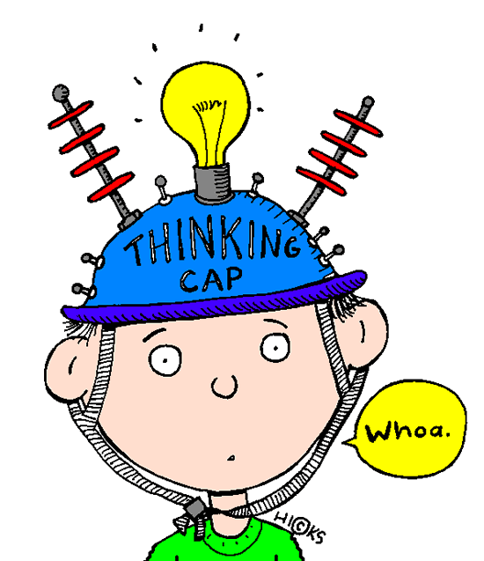
Think!
Pick one function.
Describe an experiment you could design to prove the function of this part using the independent (IV) and dependent (DV) variable.

