Slide 1
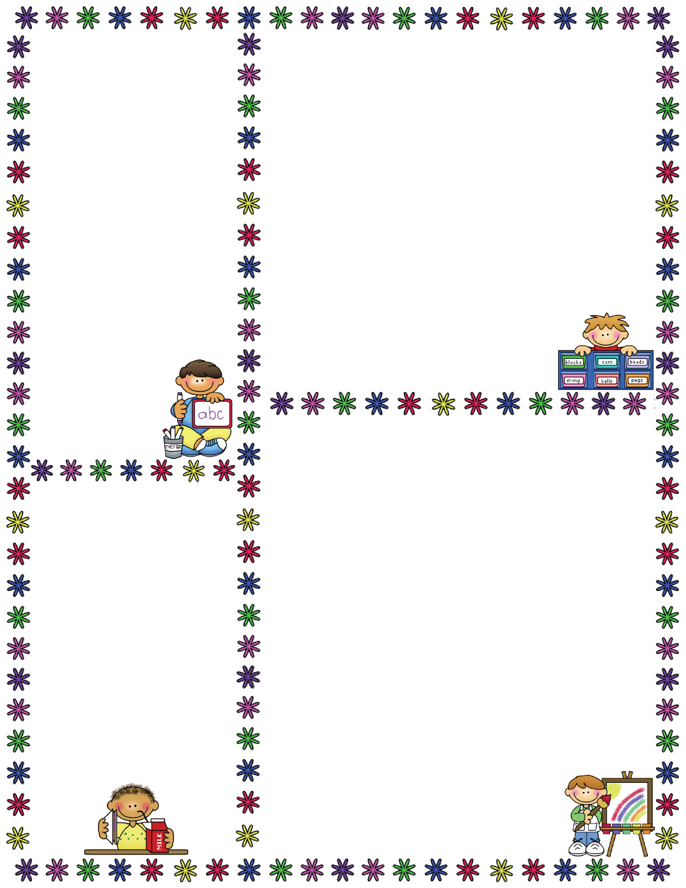
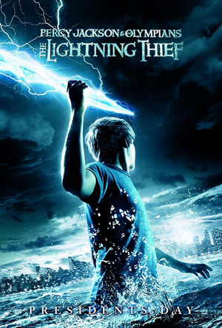
Spelling Words
Mrs. Carroll’s Class
Classroom Newsletter
October 23rd- 27th
ELA: This week we will begin reading a novel.
“Percy Jackson and the Olympians: The Lightning Thief” Chapters 1-2
No spelling test this week. There will be vocabulary test on Friday.
Vocabulary Words
Envy: feel desirous of another's advantages
wispy: thin and weak
spawn: the mass of eggs deposited by fish, amphibians, or mollusks
vital: urgently needed; absolutely needed
dyslexia: impaired ability to learn to read
triumphant: joyful and proud especially because of success
pulverize: make into powder by breaking up; cause to become dust
Dates to Remember
November 10: No School
Veteran’s Day
November 15: Early Release
November 22-24: No School Thanksgiving
Dec 8: PJ Project Due
Dec 11: PJ Test
Dec. 12: PJ Essay Test

