Slide 1
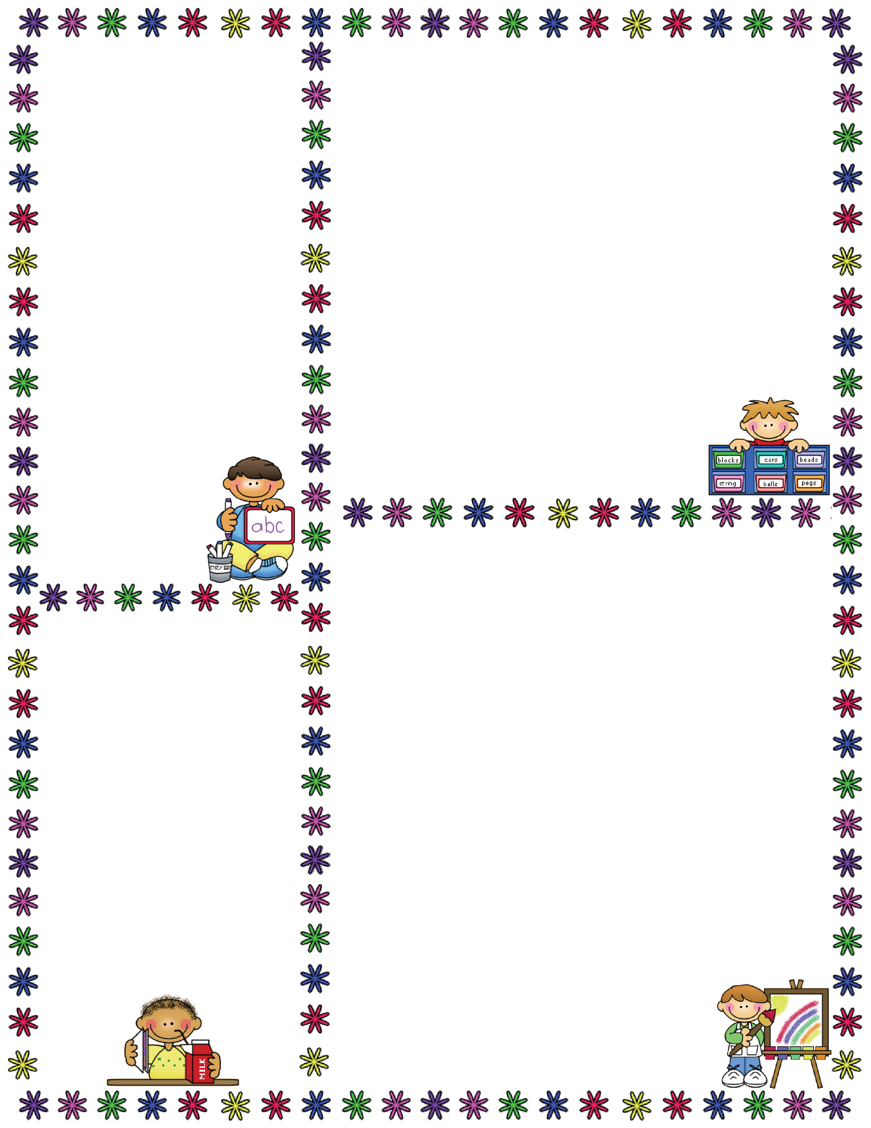
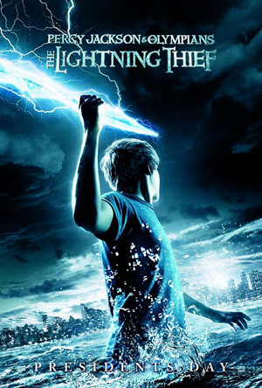
Spelling Words
Mrs. Carroll’s Class
Classroom Newsletter
November 6-10
ELA: This week we will continue reading a novel.
“Percy Jackson and the Olympians: The Lightning Thief” Ch. 8-10
No Spelling Words
Vocabulary Words
recoil: drew back as with fear or pain
gingerly: with extreme care or delicacy
pseudonym: a fictitious name used when performing a certain role
metaphysical: highly abstract or overly theoretical
convergence: the occurrence of two or more things coming together
mausoleum: a large burial chamber usually above ground
carnage: the savage and excessive killing of many people
Aura: distinctive but intangible quality around a person or thing
Dates to Remember
November 10: No School
Veteran’s Day
November 15: Early Release
November 22-24: No School Thanksgiving
Dec 8: PJ Project Due
Dec 11: PJ Test
Dec. 12: PJ Essay Test

