Slide 1
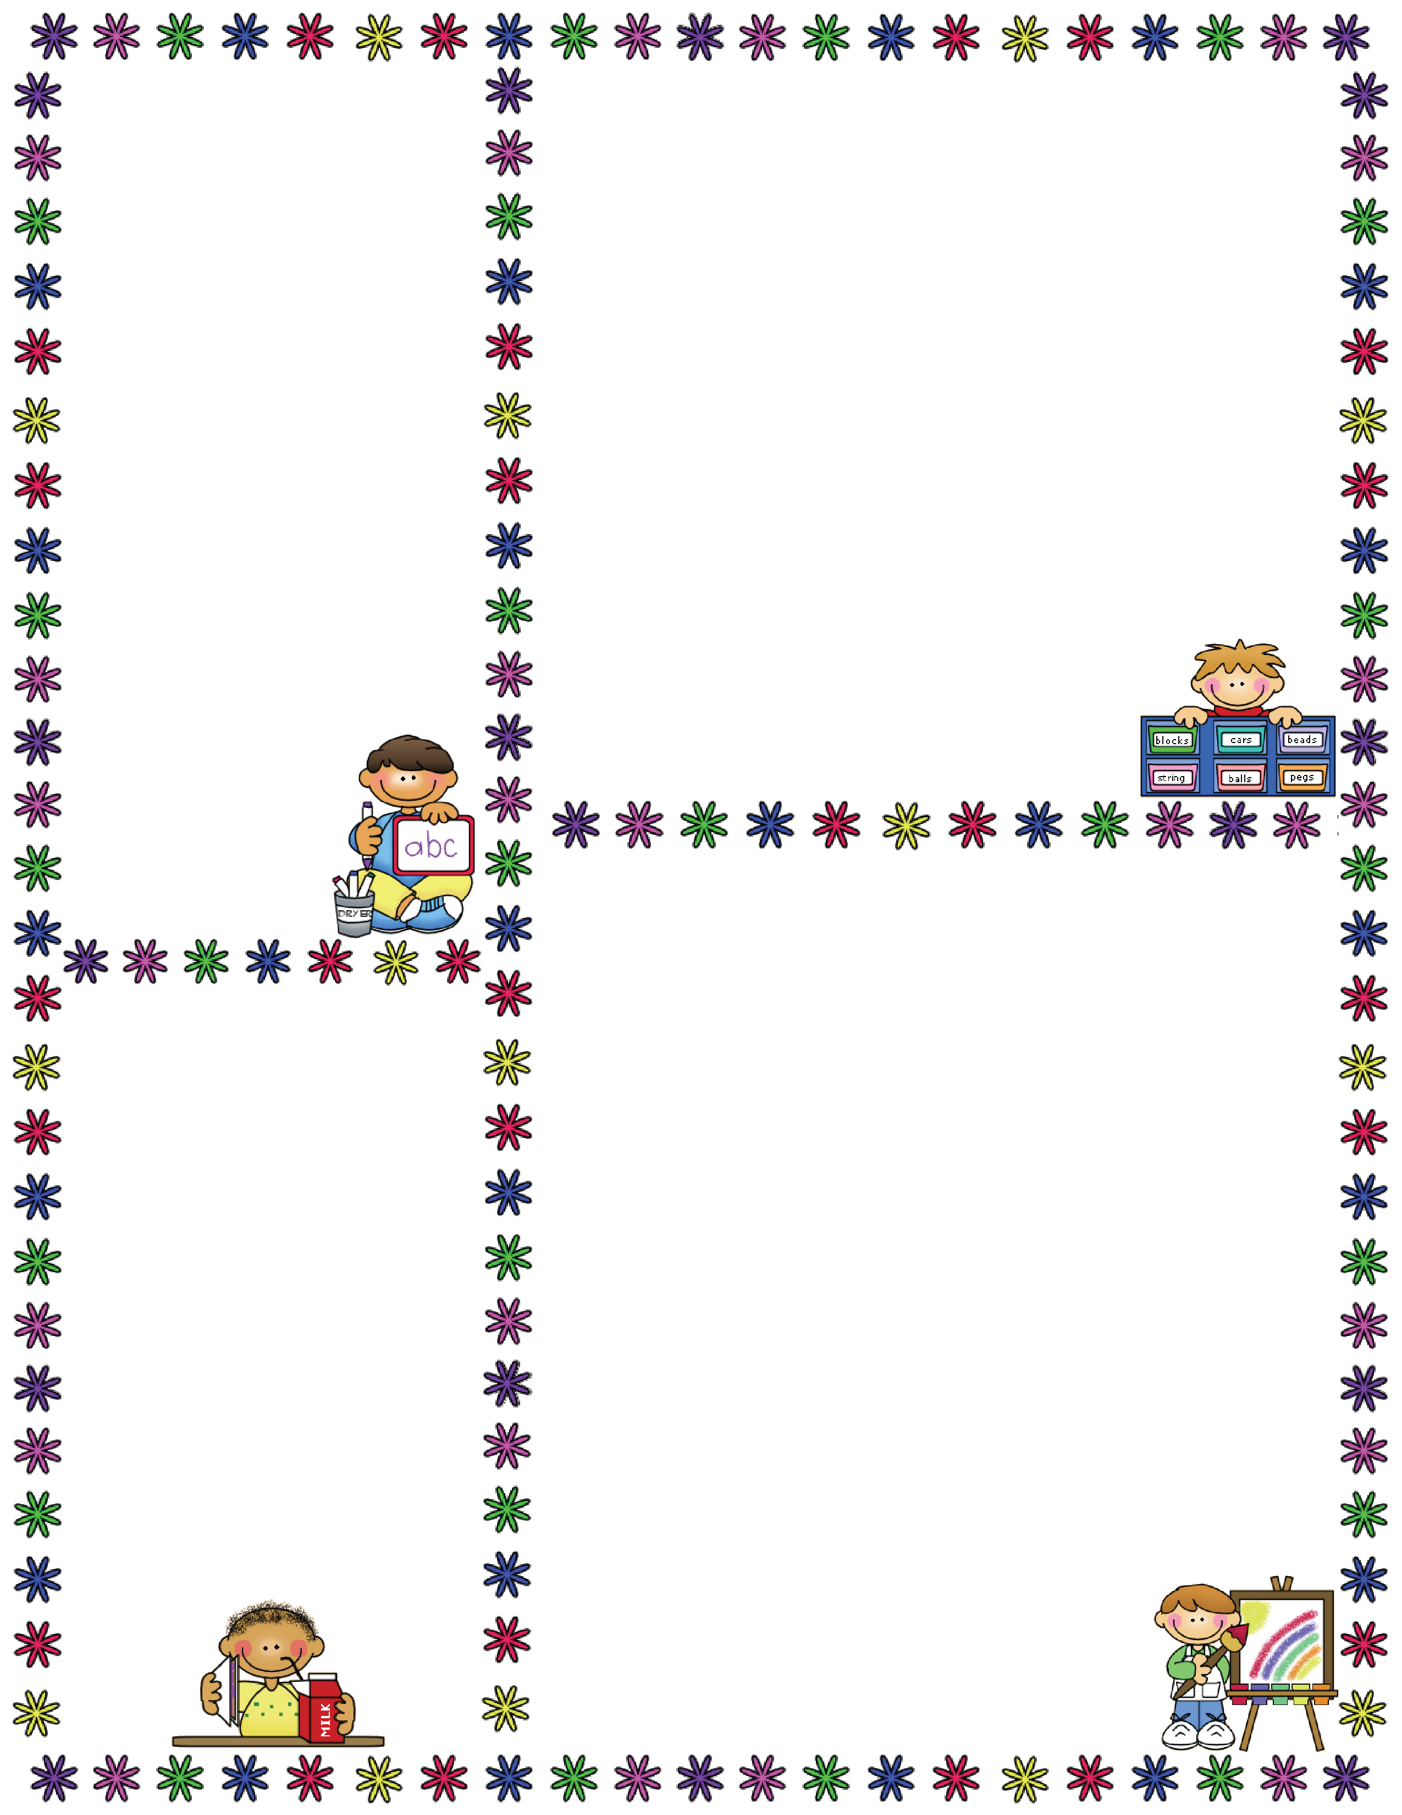
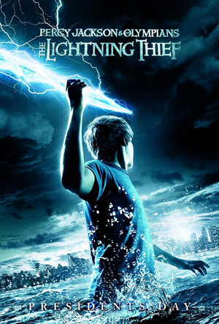
Spelling Words
wouldn’t
doesn’t
shouldn’t
couldn’t
haven’t
aren’t
I’ve
you’re
they’re
hadn’t
Mrs. Carroll’s Class
Classroom Newsletter
December 4-8
ELA: This week we will continue reading a novel.
“Percy Jackson and the Olympians: The Lightning Thief” Ch. 20-22
Vocabulary Words
baleful threatening or foreshadowing evil or tragic developments
melancholy characterized by or causing or expressing sadness
charisma personal attractiveness that enables you to influence others
ultimatum a final demand
odyssey a long wandering and eventful journey
evade escape, either physically or mentally
impudence the trait of being rude and impertinent
mimic imitate, especially for satirical effect
clamor make loud demands
glint be shiny, as if wet
vengeance harming someone in retaliation for something they have done
Dates to Remember
Dec. 8: PJ Project Due
Dec. 11: PJ Test
Dec. 12: PJ Essay Test
Dec. 19: Abbreviated Day
Dec. 20-Jan. 4: Christmas Break

