Slide 1
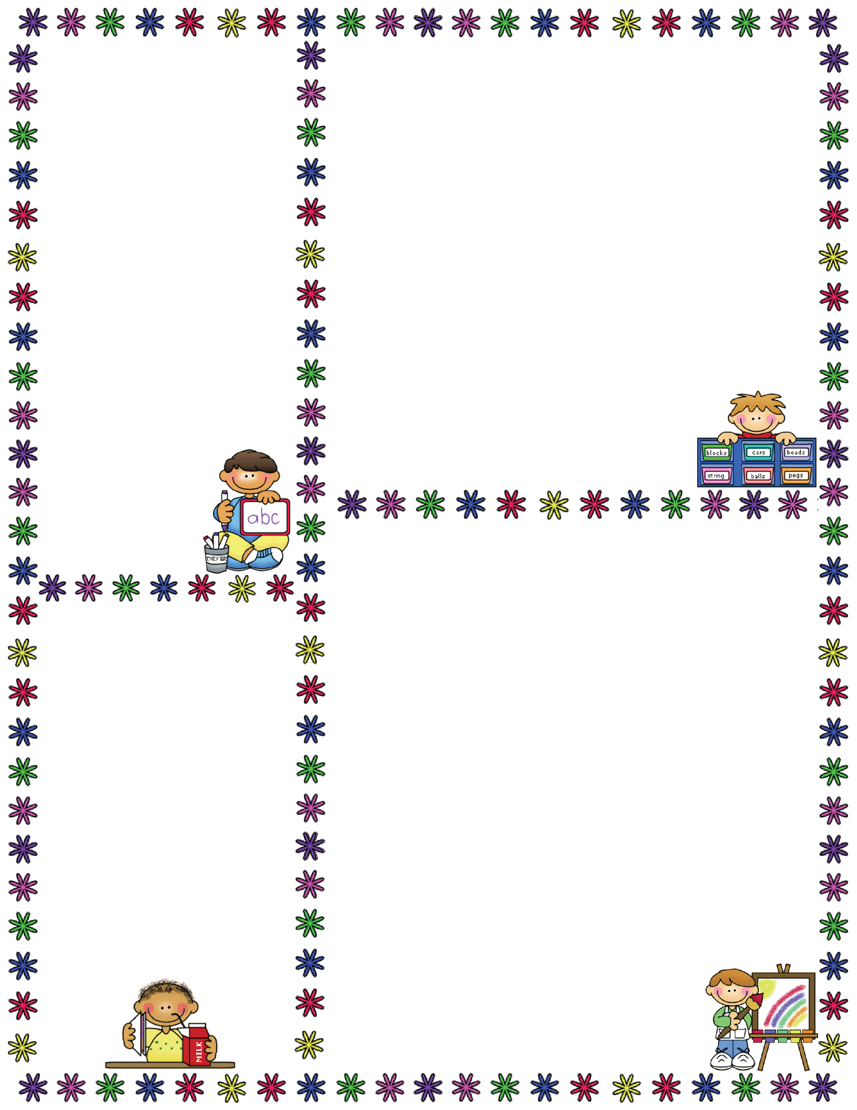
Spelling Words
No Spelling Test
Mrs. Carroll’s Class
Classroom Newsletter
December 11-15
PJ Tests and Writing Lab
Vocabulary Words
Dates to Remember
Dec. 11: PJ Test
Dec. 12: PJ Essay Test
Dec. 19: Abbreviated Day
Dec. 20-Jan. 4: Christmas Break

