Slide 1
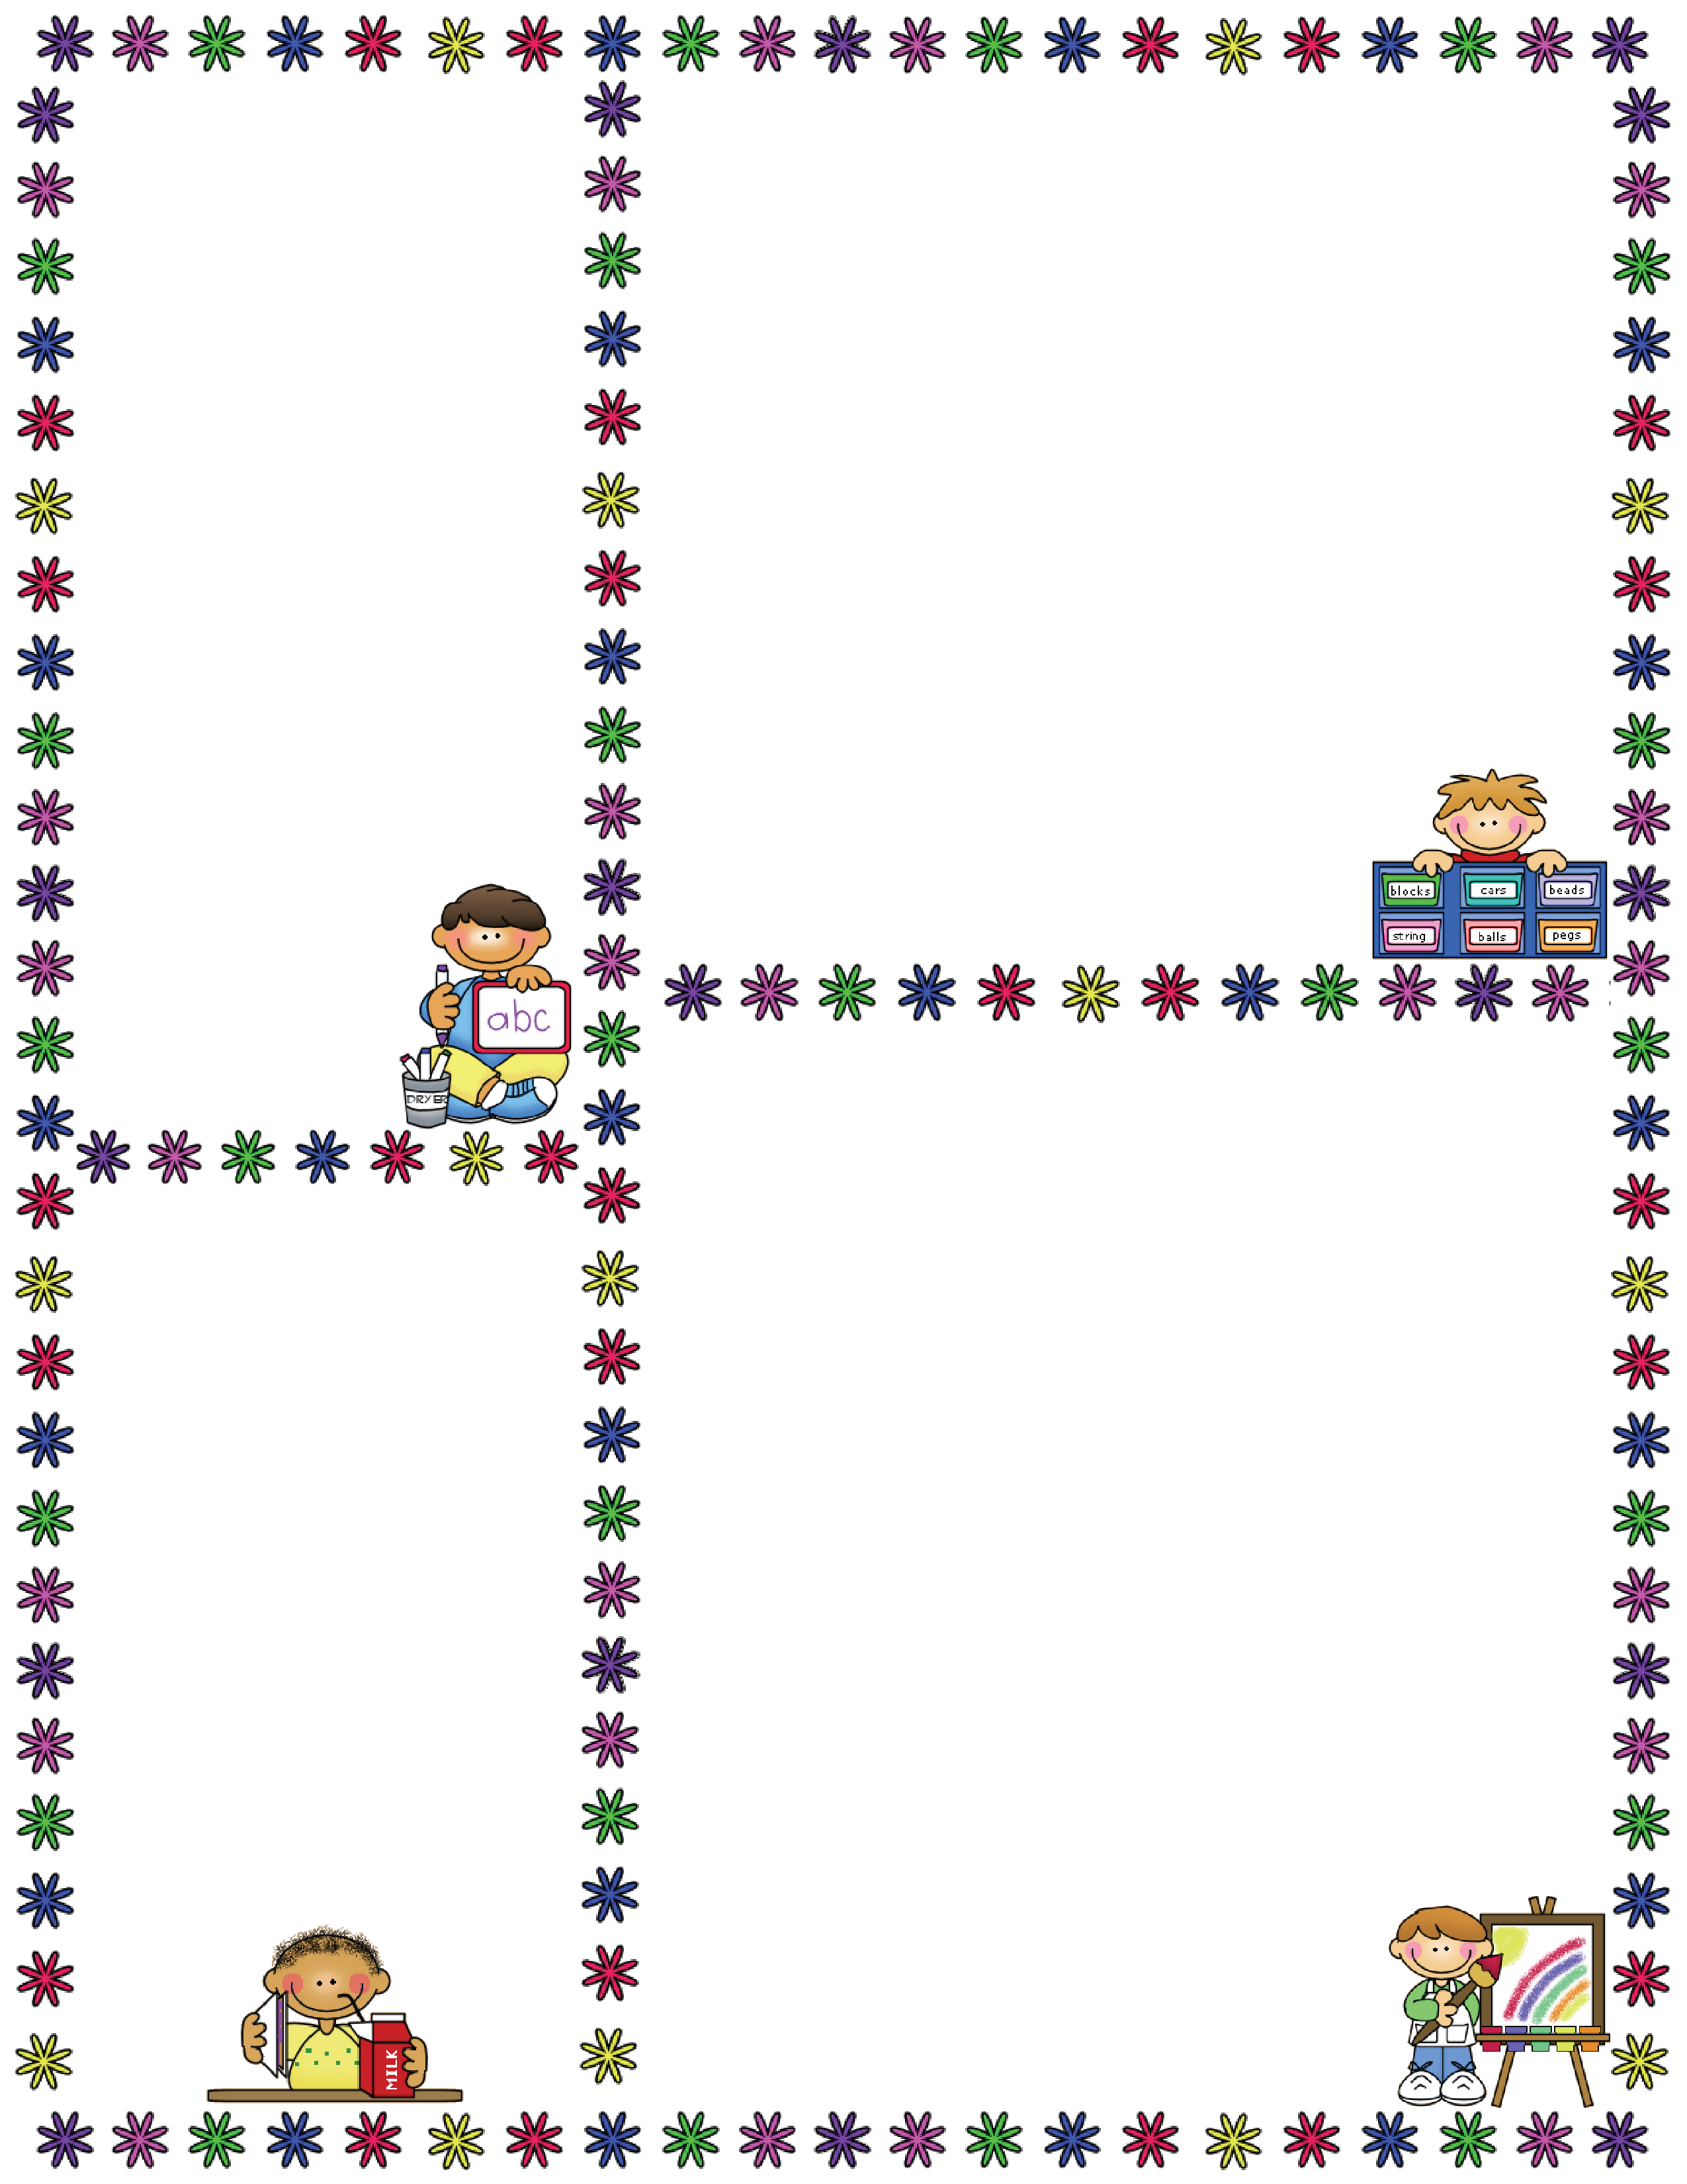
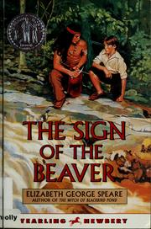
Spelling Words
Mrs. Carroll’s Class
Classroom Newsletter
September 11-15
ELA: This week we will be continuing to read
“The Sign of the Beaver” Chapters 18-22
1. Thanksgiving
2. graph
3. young
4. wheel
5. nephew
6. whisper
7. elephant
8. wharf
9. strong
10. skunk
Vocabulary Words
retort: to make a sharp answer
ordeal: a painful, difficult experience
boisterous: loud, unrestrained, and in high spirits; rowdy
venture: to go forward in spite of risk
scant: scarcely enough; very little
Dates to Remember
September 20: Early
Release Day
September 22: SOTB Projects Due
September 25: SOTB Test
September 26: SOTB Essay Test
Oct. 9-13 Fall Break

