Slide 1
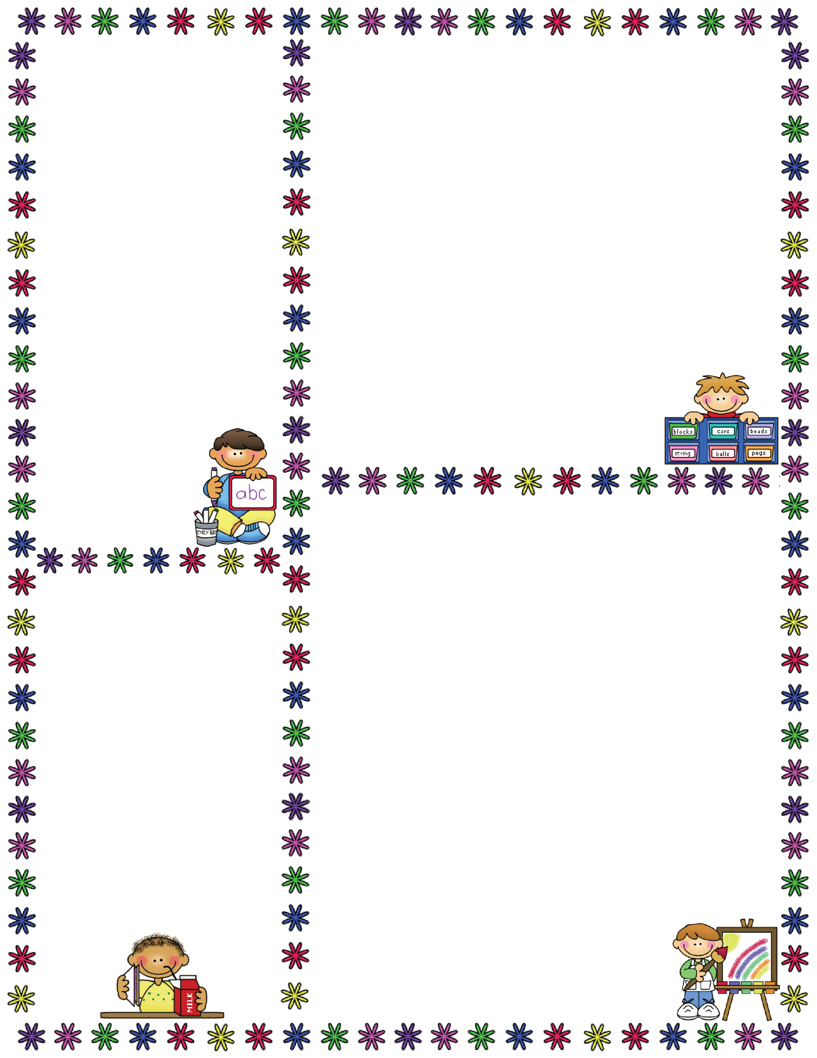
Spelling Words
Mrs. Carroll’s Class
Classroom Newsletter
September 25-29, 2017
ELA: This week we will be continuing to read
“The Sign of the Beaver” Review and Testing
No Spelling This Week
Vocabulary Words Cont.
placid: calm, smooth, or peaceful
retort: to make a sharp answer
ordeal: a painful, difficult experience
boisterous: loud, unrestrained, and in high spirits; rowdy
venture: to go forward in spite of risk
scant: scarcely enough; very little
knack: natural talent; ability with ease
flounder: to move forward in a clumsy way; often losing balance
clamor: loud noise that goes on for sometime
fend: to try to provide for one’s own needs
Vocabulary Words
daubed: to smear or cover with soft sticky material such as plaster
ruefully: feeling, showing, or causing regret or sorrow
coax: obtain by patient, gentle persuasion
hemlock: an evergreen tree of North America with short needles and small cones
expedition: a journey taken for a reason
shambles: a place or condition of disarray or destruction
endure: to bear up under or function in spite of
hobble: to walk with trouble or in an awkward manner; limp
defiance: bold disobedience; lack of respect for authority
finicky: exceptionally fussy or hard to satisfy
grudgingly: reluctant or unwillingly
adz: an ax-like tool with a curved, sharp edged head set crosswise to the wood
snare: a trap for catching small animals
nonchalant: not showing excitement or care; coolly confident
suspicion: the act of not believing or suspecting
ponder: to think about something deeply and carefully
puny: very small or weak; feeble
envious: showing or feeling envy or desire for what another has
indignant: feeling or showing anger about something considered to be unfair
goad: to spur on to action
immense: very large; huge
solemn: serious in appearance, sound, or mood
hideous: ugly or frightening
pungent: sharp and strong in taste or smell
dignity: pride or respect as shown in one’s appearance or behavior
discard: to throw out or away; cast off
Dates to Remember
September 20: Early
Release Day
September 22: SOTB Projects Due
September 25: SOTB Test
September 26: SOTB Essay Test
Oct. 9-13 Fall Break

