Slide 1
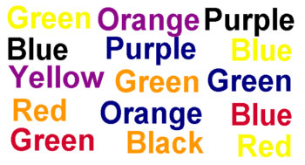
Starting in the upper left, say the name of the color of each word,
not the word itself.

Slide 2
Explanation: While your brain’s right hemisphere is processing the color, your left hemisphere is interfering as it attempts to process the actual word.

Slide 3
Conundrums
Puzzles/Riddles

Slide 4
Paradox
Nobody goes to that restaurant; it’s too crowded.
Answer truthfully (yes or no) to the following question: Will the next word you say be ‘no’?

Slide 5
CONUNDRUM – a difficult problem or question
Name an ancient invention still in use in most parts of the world today that lets people see through walls.

Slide 6
CONUNDRUM – a difficult problem or question
Name an ancient invention still in use in most parts of the world today that lets people see through walls.
A WINDOW

Slide 7
CONUNDRUM
HOW COULD A TODDLER FALL OUT OF A THIRTY-STORY BUILDING ONTO THE GROUND AND SURVIVE?

Slide 8
CONUNDRUM
HOW COULD A TODDLER FALL OUT OF A THIRT-STORY BUILDING ONTO THE GROUND AND SURVIVE?
The baby fell from the ground floor window.

Slide 9
RIDDLE
What goes up the chimney down, but can’t go down the chimney up?

Slide 10
RIDDLE
What goes up the chimney down, but can’t go down the chimney up?
An umbrella

Slide 11
What do you see first?

