Slide 1
Alliterations
al·lit·er·a·tion
əˌlitəˈrāSHən/
noun
plural noun: alliterations
the occurrence of the same letter or sound at the beginning of adjacent or closely connected words.

Slide 2
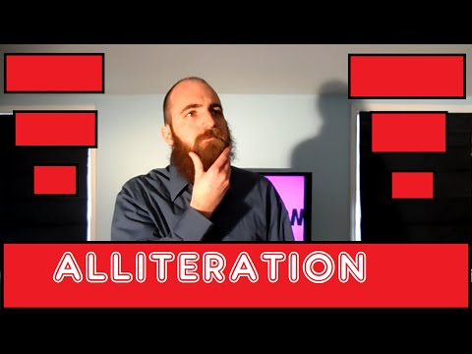
Alliteration Rap

Slide 3
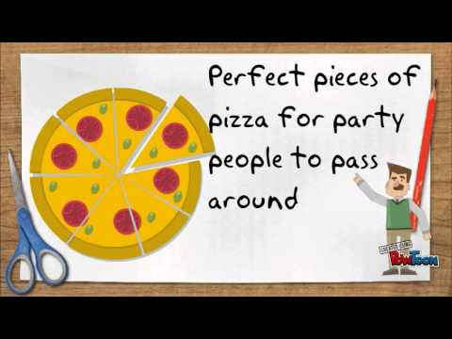
Onomatopoeia, Alliteration and Assonance for kids

Slide 4
Peter Piper

Slide 5
Practice, Practice, Practice!
Alliterations or Simile Quiz
Lesson Alliteration
Wizards and Pigs; Alliteration Practice

Slide 6
Brainstorm
Joyous Jason joyfully jogs his giraffe before jumping on a jumbo jet to eat jiggle jelly with a jolly giant.
Nouns | Verbs | Adjectives
Jam | Jogging | Joyful
Jelly | Jump | Jolly
Jet | Jiggle | Joyous
Giraffe |  | Jumbo
Jason
Giant

Slide 7
Alliterations Using the B Sound
1. Janie read a book by the babbling brook.
2. The child bounced the ball at the backyard barbeque.
3. The barbarians broke through the barricade.
4. He acts silly at times, but he was blessed with a brilliant brain.
5. The beautiful bouquet blossomed in the bright sun.

Slide 8
Using the “C” “K” Sounds
6. When the canary keeled over, the coal miners left the cave.
7. The captain couldn’t keep the men in the cabin.
8. Erin cooked cupcakes in the kitchen.
9. My Cadillac was completely crushed in a car crash.
10. The candy was killing my cavity.

Slide 9
Using the “Ch” Sound
11. Despite their mother’s warnings, the children chose to chew with their mouths open.
12. The rich man was so cheap that it was chilling.
13. The crowd cheered when the champion hit the challenger with a chair.
14. We sat around the campfire and chomped on chunks of charred chicken.
15. Change the channel.

Slide 10
Using the “D” Sound
16. They would have been on time, if they didn’t dilly-dally.
17. He dunked the delicious donut in dairy creamer.
18. There is nothing but death in the desert during the day.
19. I woke up at school in a slobbery pool; though I used to be dry, now I’m drowning in drool.
20. I dreamt of a drip-dropping drain in my dream.

Slide 11
Using the “F” and “Ph” Sound
21. Your friends will flip-flop fast when facing trouble.
22. Our financial future fell into a freefall.
23. The stuntman flipped from a forty foot Ferris wheel.
24. I forgot my flip phone but felt free.
25. That’s the first photo of France from the Moon.

Slide 12
Using the “G” Sound
26. When the tests were distributed, the guys grimaced and groaned.
27. The girl grabbed the golden goose and ran.
28. Grass grows greener in the graveyard.
29. The ghouls and ghosts greeted the gangly goblins.
30. I reached under the desk and grabbed the gross gum.

Slide 13
Using the “H” Sound
31. The hummingbirds hovered in heavenly harmony.
32. She happily helped the homeless.
33. The hecklers hassled the humble harmonica player.
34. After Monique dumped Brian, his heart hung heavily.
35. Those horses have heavy hooves.

Slide 14
Using the “J” and “G” Sounds
36. The gentle giant jumped in jubilation.
37. Juggling jack o’lanterns is my job.
38. He jabbed the javelin into the jail cell.
39. Jellyfish have germs and jarring toxins.
40. The gym was jammed with jelly jars and junk.

Slide 15
Using the “L” Sound
41. Whenever he lied, he lisped a little.
42. The lion licked his lips.
43. Feeling rather lazy, he laid low in the lounge.
44. We lamented the Lord’s lost labor.
45. Her love languished in the limelight.

Slide 16
Using the “M” Sound
46. Menacing sounds of mashing metal machines emanated from the mines.
47. All of the millionaire’s money only made him more melancholy.
48. My mother makes a mouthwatering mincemeat pie.
49. There are madmen in the middle of those mountains.
50. Most monsters don’t mind making messes.

Slide 17
Using “N”, “Gn”, and “Kn” Sounds
51. My neighbors are not normally noisy.
52. I knew that she’d be a natural at kneading the noodle dough.
53. The ninjas gnashed their knives and nailed their targets.
54. The newt nuzzled in a narrow nook.
55. Mom nabbed her niece by the nape of her neck.

Slide 18
Using the “P” Sound
56. The prince pressed the royal seal on the purple parchment.
57. A paper plane passed over my head.
58. The parrot perched upon the pirate’s peacoat.
59. Sue went to the party and pretended that she was people person.
60. The girls played patty-cake on the park bench.

Slide 19
Using the “R” and “Wr” Sounds
61. The red roses were wrapped in ribbons.
62. She rarely reads; she’d rather write her own books.
63. A radar ring rippled across the monitor.
64. Those ravenous research rabbits have gone rabid!
65. The reporter wrote about the rebel raid.

Slide 20
“S” and “C” Sounds
66. The snake slithered across the sandy seaside.
67. My sassy sister slapped the villain silly.
68. That’s the sound of someone sipping soup for supper.
69. She sniffed and smelled sage and sassafras.
70. Seeking sanctuary, they formed a circle of spears.

Slide 21
Using the “Sh” Sound
71. She should share her sherbert with her sister.
72. A shard of shrapnel shaved her shoulder blade.
73. The sheep were schlepping shyly by the shark tank.
74. He found a shell that even shimmered in the shade.
75. The sheriff wore a shiny star shaped shield.

Slide 22
Using the “St” Sound
76. The store clerk stood and stared at me in stupor.
77. She stuck the stolen stapler in her suitcase.
78. The students threw stones through the stained glass steeple.
79. Everything rested on the strength of the steel structure.
80. Stern winds strew still waters.

Slide 23
Using the “T” Sound
81. The teacher took the troublemakers’ toys.
82. They trounced us in the tried and true tradition.
83. The tattle-tale tried to tell the teacher.
84. Try the turkey tacos; they’re quite tasty.
85. The tornado tossed the trailer like a trash can.

Slide 24
Using the “V” Sound
86. The vapid vixen vented her various vexations.
87. Valiance is a virtue often vacant from these vermin.
88. We viewed the verdant valleys vaunted vegetation.
89. The ventriloquist varied his voice vociferously.
90. Her views on vices were vaguely veiled at best.

Slide 25
Using the “W” Sound
91. The wind was whistling through the weeping willows.
92. Construction workers whistled at the women.
93. We welcomed all the wise men from the West.
94. Don’t wage a war of words against the world.
95. The waffles worsened while the waiter waited.

Slide 26
Using “Y”, “Eu”, and “U” Sounds
96. In her youth she yearned to wander yonder Europe.
97. I’m used to yelling at you yellowbellies.
98. Your usefulness was used up yesterday.

Slide 27
Using “Z” and “X” Sounds
99. My zodiac was zooming toward the zenith.
100. The xanthous xenophobes were overzealous.
101. The player zipped by the zonal defense and zeroed in on the end zone.
http://www.ereadingworksheets.com/figurative-language/poetic-devices/alliteration-examples/

Slide 28
Alliteration Examples
Mrs. Stone sat on a stone as she secretly sipped starbucks smoothies at school.
Maximus made movies marveling at monster madness with his friend Mayan.

