Slide 1
Apostrophe’s

Slide 2
An apostrophe is used to show possession or ownership.
When something belongs to someone, a group of people, or an object add an apostrophe and an “s”.

Slide 3
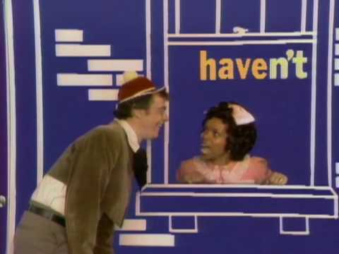
N apostrophe T

Slide 4
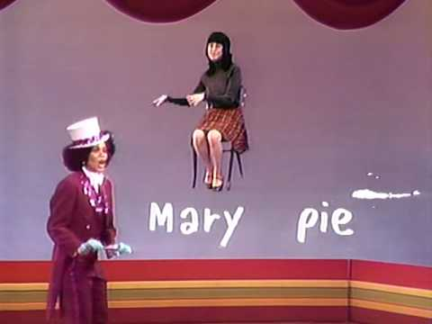

Slide 5
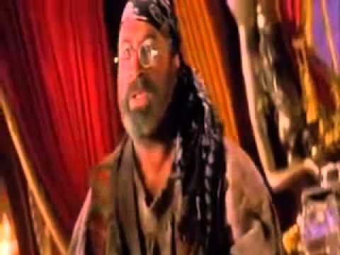
I’ve just had an apostrophe

Slide 6
Online Practice
Apostrophe's Quiz
Time for Kids: Apostrophes

