Slide 1
MATTER
IS ANYTHING THAT HAS MASS AND VOLUME

Slide 2
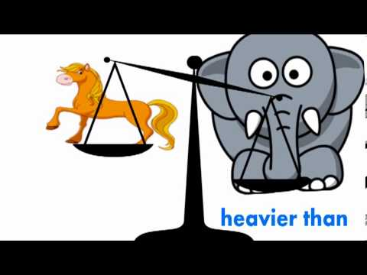
MASS
THE AMOUNT OF MATTER IN AN OBJECT

Slide 3
VOLUME
THE AMOUNT OF SPACE MATTER TAKES UP

Slide 4
3 STATES OF MATTER
SOLID
LIQUIDS
GASES

Slide 5
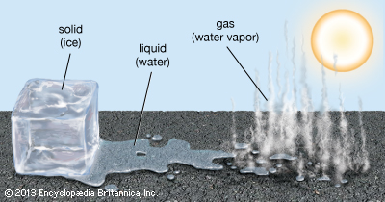

Slide 6
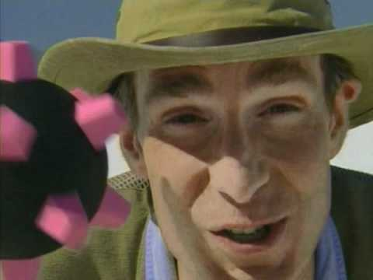
ALL MATTER IS MADE OF TINY PARTICLES CALLED ATOMS

Slide 7
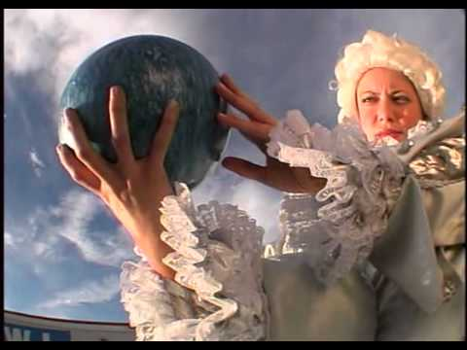

Slide 8
PHYSICAL PROPERTIES
Used to describe and observe matter. Appearance, texture, color, odor, melting point, boiling point, density, solubility, polarity, and many others.

Slide 9
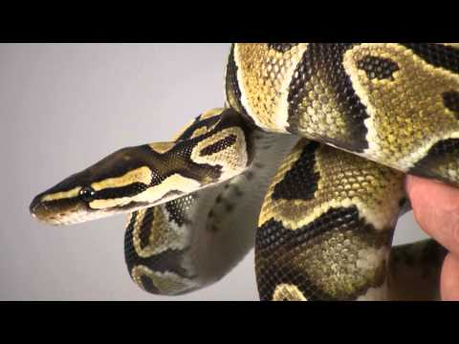
TEXTURE
The feel, appearance, or consistency of a surface or substance.

