Slide 1
Poetry
What do you know about poetry?

Slide 2
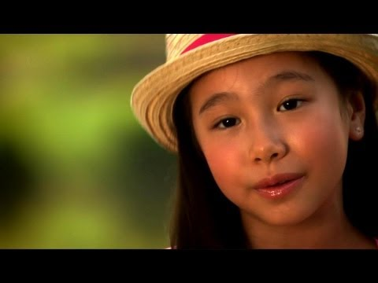
Poem
A piece of literature that:
Has a rhythm
Often rhymes or repeats
Expresses a feeling or idea

Slide 3
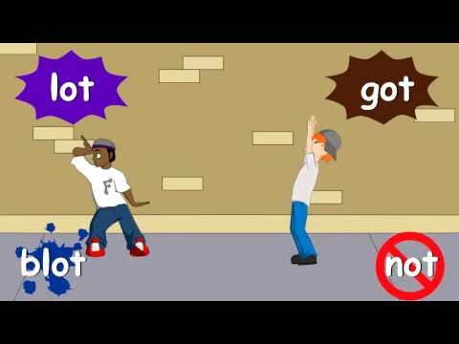
Rhyme
One of two or more words that end in the same sounds.

Slide 4
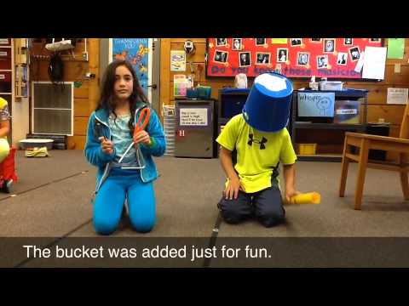
Rhythm
A regular repeated pattern of sounds or movements.

Slide 5
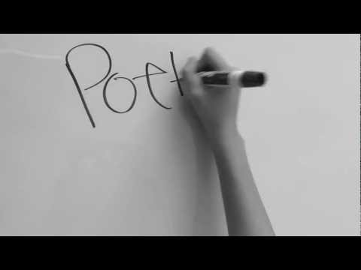
Repetition
The act of something that is done again and again.

Slide 6
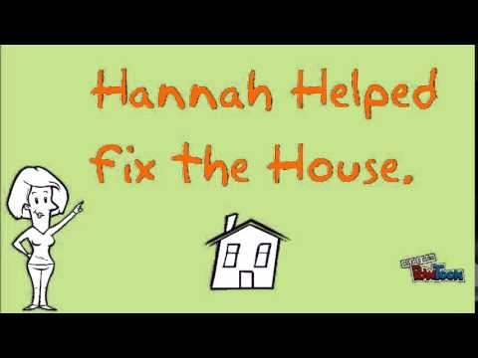
Alliteration
Repetition of the first sound or sounds in a group of words.
Sally sells seashells by the seashore.

Slide 7
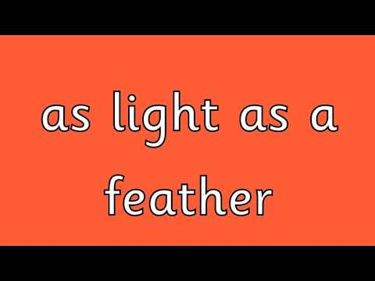
Simile
A comparison of two objects, people, or things using the words “like” or “as”.
She shines like the sun.

Slide 8
Stanza
Several verses grouped together in a poem. Similar to a paragraph in a story.

Slide 9
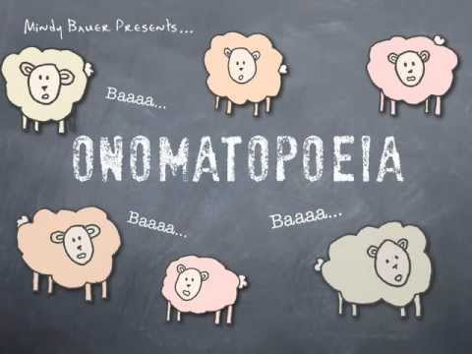
Onomatopoeia
Words that imitate sounds. Also called sound words.
Crunch, pop, bang

Slide 10
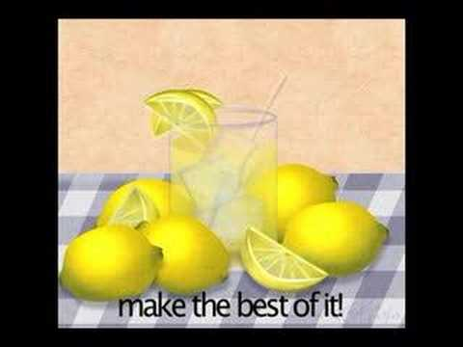
Metaphor
A direct comparison of two objects, people, or things. Often uses “is”, “was”, “are”, or “were”.
He is a shining star.

Slide 11
Idiom
An old saying that does not mean what it says.
Cat got your tongue?

Slide 12
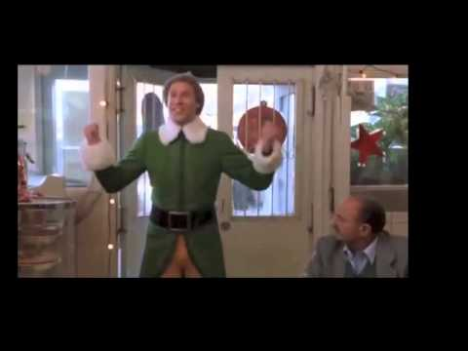
Hyperbole
An over-exaggeration.
I’m so hungry, I could eat a horse.

Slide 13
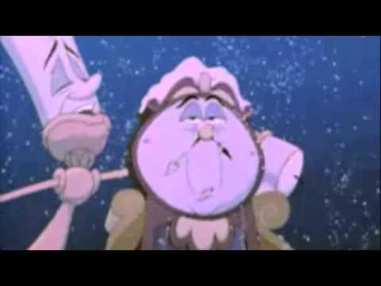
Personification
Giving human characteristics or abilities to non-human objects or things.
The rain pounded on the window.

Slide 14
Verse
A line in a poem. Similar to a sentence in a paragraph.

