Slide 1
Pronouns

Slide 2
What is a pronoun?
A pronoun is a word that takes the place of a noun. Instead of using the proper name, it is a more generalized term for that noun,
Example:
I, me, he, she, them, they, her, him, themselves, myself, someone, everybody, ect

Slide 3
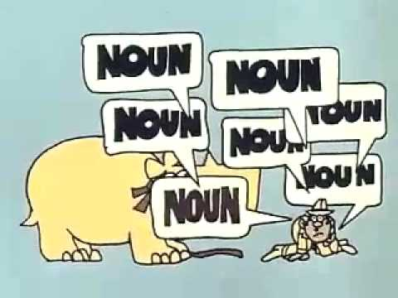

Slide 6
ONLINE PRACTICE
https://sites.google.com/site/easygrammar4kids/pronouns

