Slide 1
Electricity

Slide 2
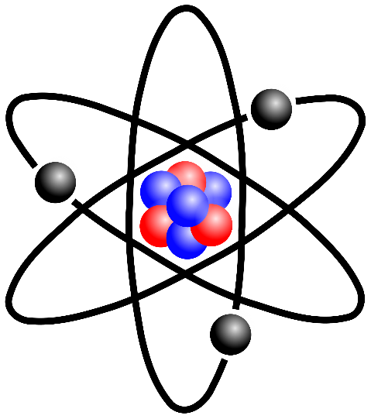
Back to Basics
What are the parts of an atom, what are their electrical charges and where are they located?
Proton: positive charge; located in the nucleus
Neutron: neutral charge; located in the nucleus
Electron: negative charge; freely moving outside the nucleus
What is electricity?
The flow of electrons

Slide 3
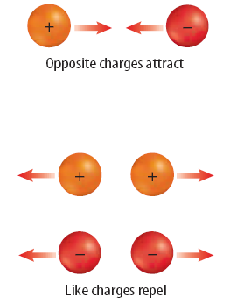
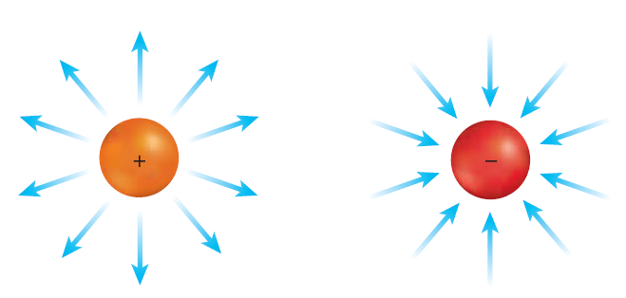
Electric Force
Electric Field
Law of Charges
Area surrounding charged particle where electric force is present
The arrows show how a positive charge would be “pushed” or “pulled”
Greater the charge, the greater the electric force
The closer the charges, the greater the electric force

Slide 4
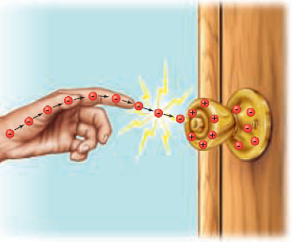
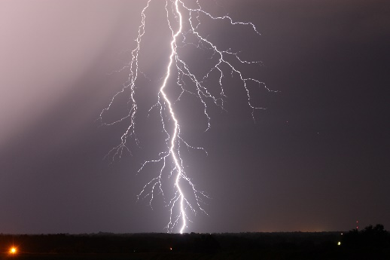
Static Electricity
Some electrons bounds more tightly to atoms than others
Electrons in your shoes bound more tightly than electrons in the carpet
What happens when you walk across a carpet?
Electrons from carpet transferred to shoes
Shoes have excess of electrons, so negatively charged
Static electricity: accumulation of excess electric charge on an object
Static discharge: electrical current passes thru air from a negatively charged object to a positively charged object

Slide 5
Conductors & Insulators
Conductors
Electrons move freely in material
Insulators
Electrons do not move freely in material
Metals
Water
Copper
Silver
Gold
Human body
Plastic
Glass
Wood
Rubber
Paper

Slide 6
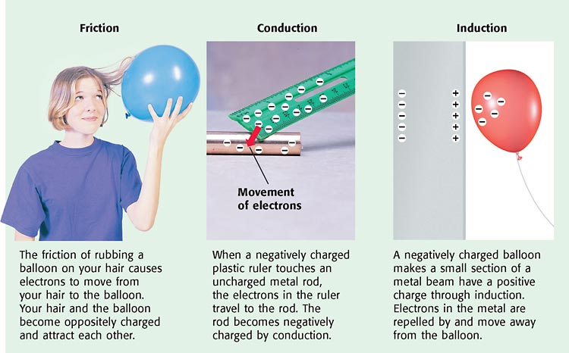
Charging Objects

Slide 7
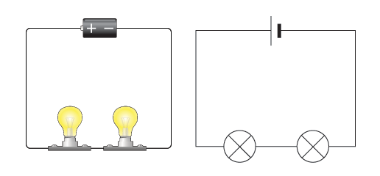
Circuits
Circuit: closed path that electric current follows
Circuit must have 3 things
Energy source (battery)
Conductor (wires)
Load (light bulb, buzzer, etc.)
Resistance: opposes the flow of current
Conductors have lower resistance than insulators
Thicker and shorter wires have less resistance than thinner and longer wires

Slide 8
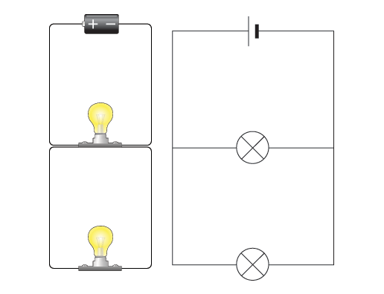
Types of Circuits
Series Circuit
Parallel Circuits
Single path for current to flow
If circuit breaks, then all devices fail
If more lights added, they get dimmer
More than one path for current to flow
If circuit breaks, then current passes thru other paths and those devices continue to work
If more lights added, brightness stays the same

Slide 9
Circuit Symbols
We use symbols to represent different parts of the circuit
Wire: to pass current easily from one part of circuit to another
Battery: to supply energy; the larger line is positive terminal
Switch: allows current to flow thru circuit when in “on” (closed) position; this switch is “off” (open)
Light: converts electrical energy into light energy

Slide 10
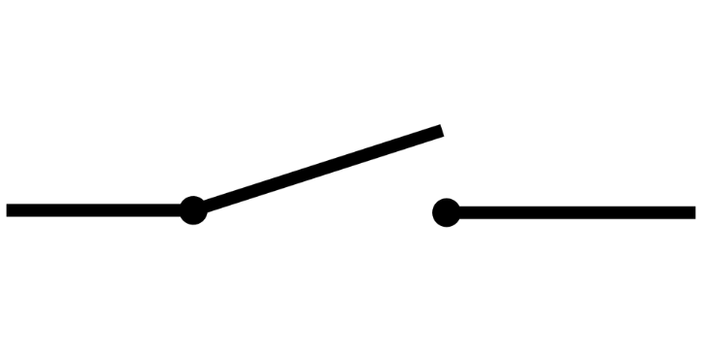
Switches
A device that allows a circuit to be closed (turned on) or open (turned off)
Closed switch: current can flow
Circuit is “on”
Open switch: current can not flow
Circuit is “off”

Slide 11
Questions?

