Slide 1
I. Aztec Civilization

Slide 2
A. G-Geography
Located in the valley of Mexico around lake Texcoco
Most of Mexico has mountains-Sierra Madre
Southern part is tropical forests and northern is deserts

Slide 3
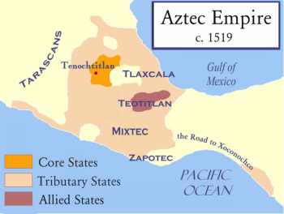

Slide 4
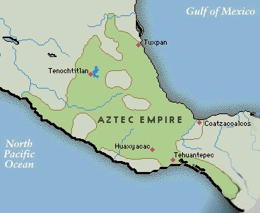

Slide 5
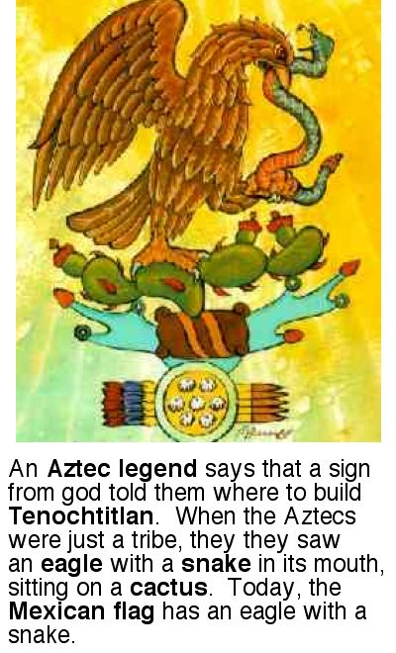

Slide 6
Aztec Capital was: Tenochtitlan
1. How did they adapt to this environment?
They built what are called chinampas- floating gardens or the city itself
They also built bridges and causeways to connect to mainland
Aqueducts to bring them water
Dikes to prevent flooding

Slide 7
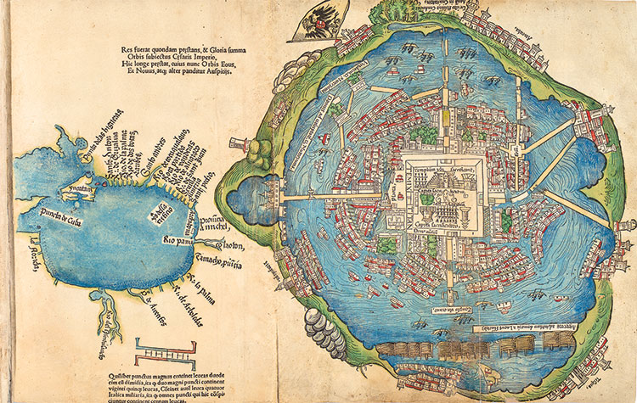

Slide 8
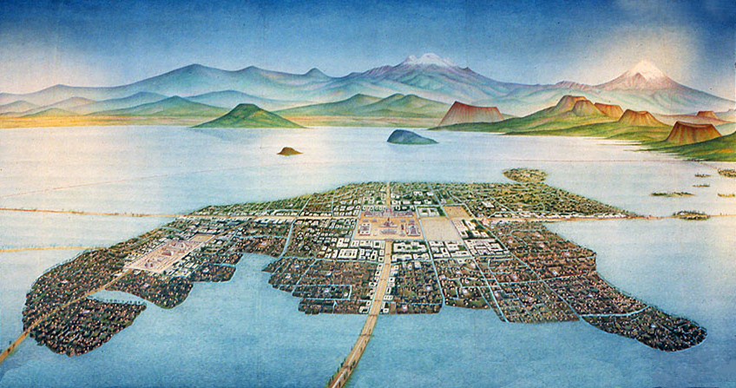

Slide 9
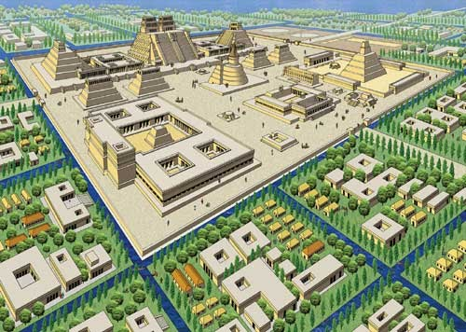

Slide 10
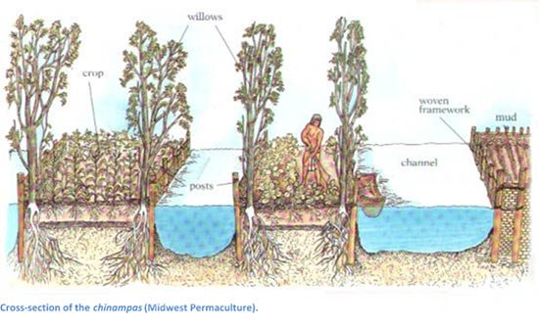

Slide 11
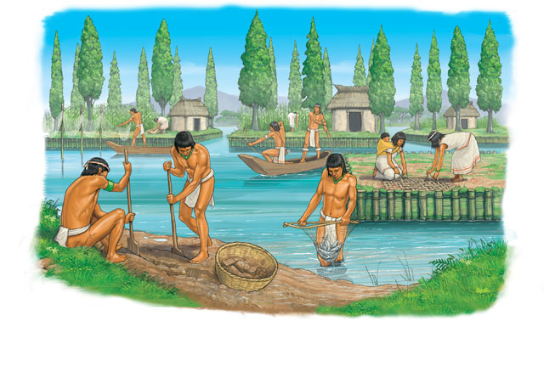

Slide 12
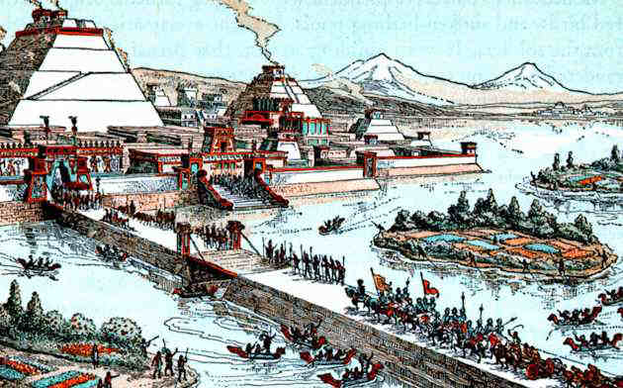

Slide 13
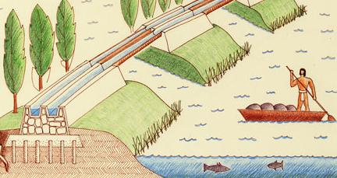

Slide 14
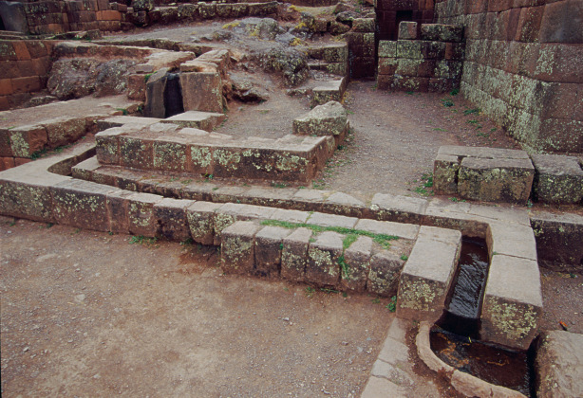
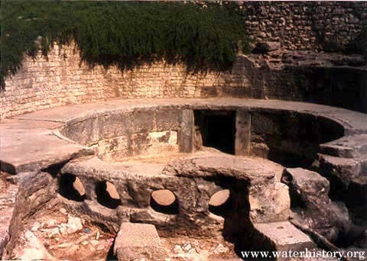

Slide 15
B. R-Religion
Polyiestic- their gods required blood and sacrifices or gods would become angry
Had ceremonies, holidays, rituals, ext.

Slide 17
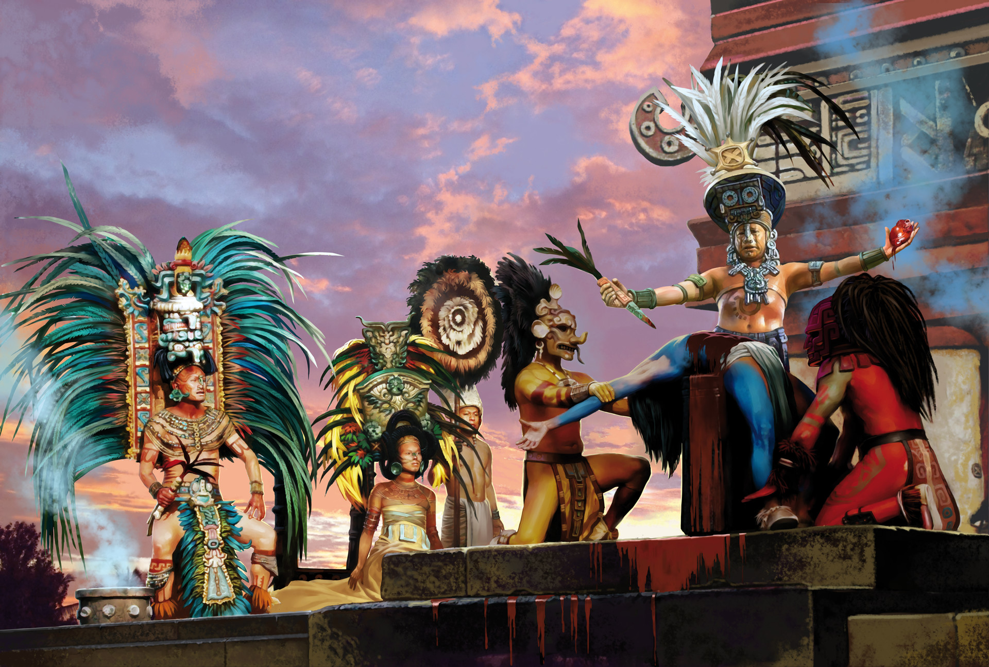

Slide 18
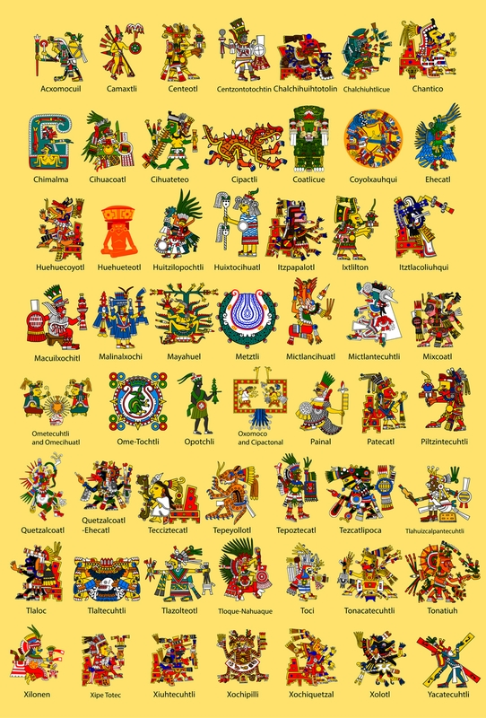

Slide 19
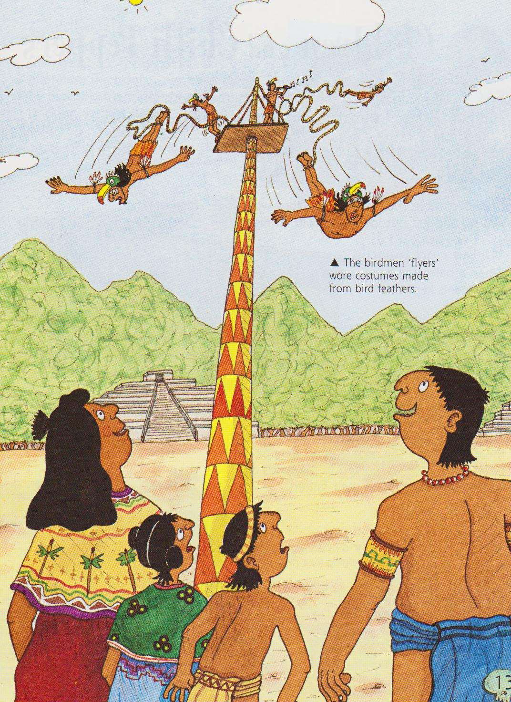
Birdmen
The Holy Birdman game or ‘Volador’ was a bit like bungee jumping.
They dressed up as birds and climbed a 70-metre high post.
One sat on a platform at the top playing a flute and drum.
The others tied ropes around their bodies and jumped off the post.
They each swung round 13 times, getting upright just before they hit the ground!
Picture p13 large Aztec book

Slide 20
C-A-Achievements
One of the largest empires in the Western hemisphere
Skilled engineers- causeways, dikes, aqueducts, city on a lake, bridges
Chinampas
Number system

Slide 21
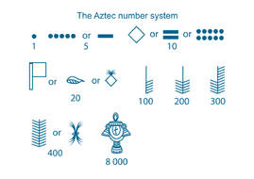

Slide 22
2 calendars
Medicine and surgeries
Architecture
Sculptures, and art
First system to educate everyone
Writing system-glyphs

Slide 23
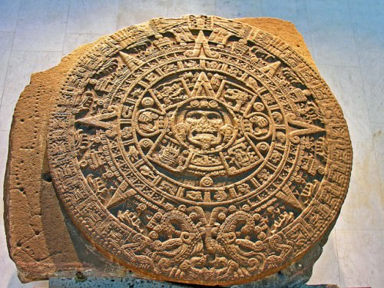
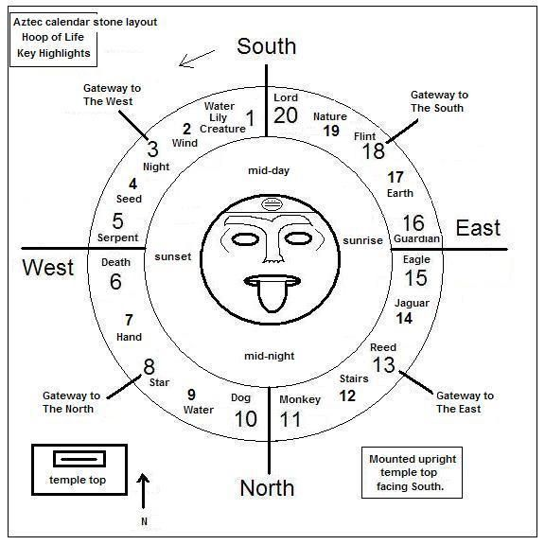

Slide 24
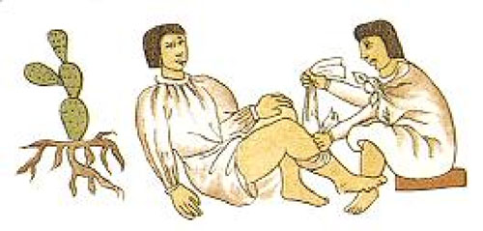
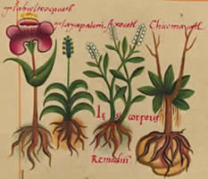

Slide 25
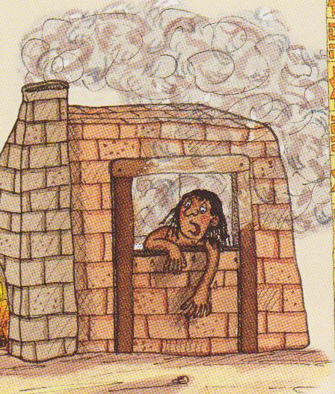
Aztec Medicine
Aztec doctors used a mix of herbs, magic and religion.
They made powerful ‘cures’ from plants or mushrooms that sometimes sent their parents mad or even killed them.
The Aztecs believed illnesses were caused by evil spirits, or were punishments from the gods.
They tried to drive out the spirits by making patients sweat in mud-brick steam baths and by saying prayers and making offerings to the gods.

Slide 26
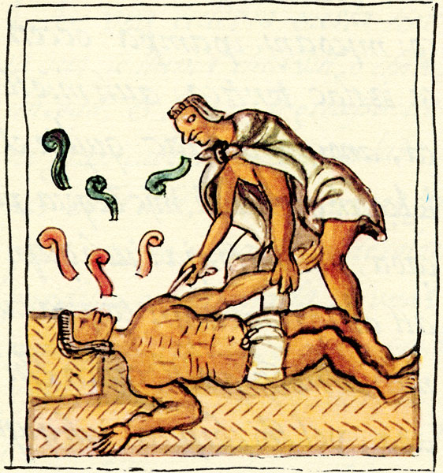
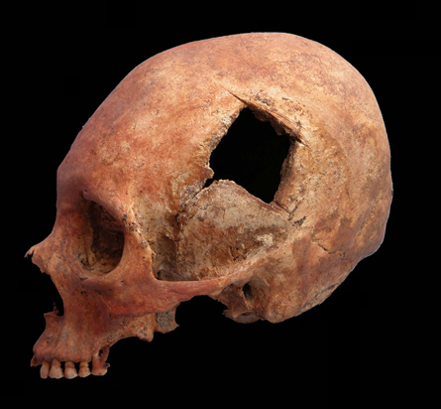

Slide 27
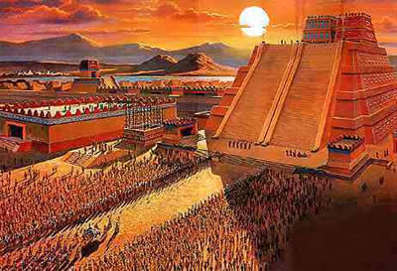

Slide 28
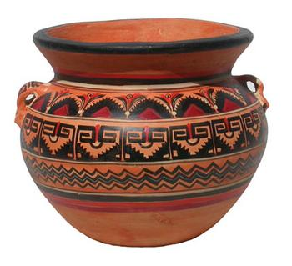
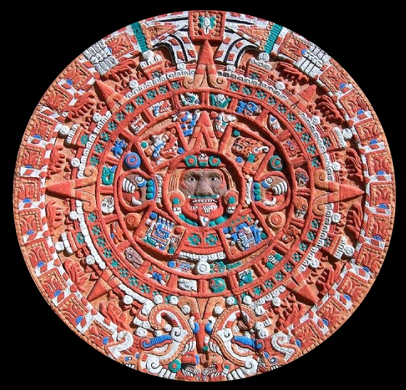
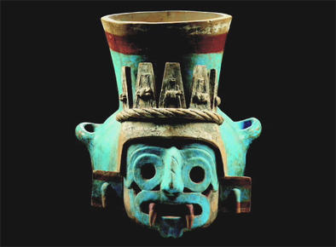
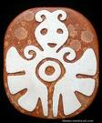
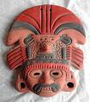
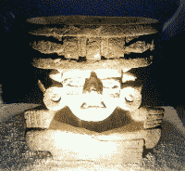
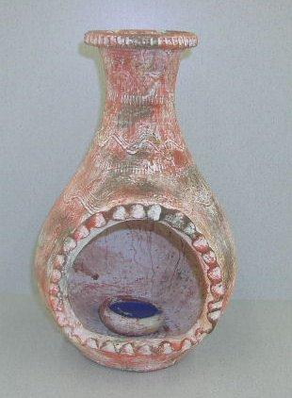
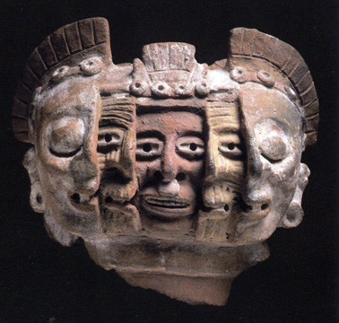
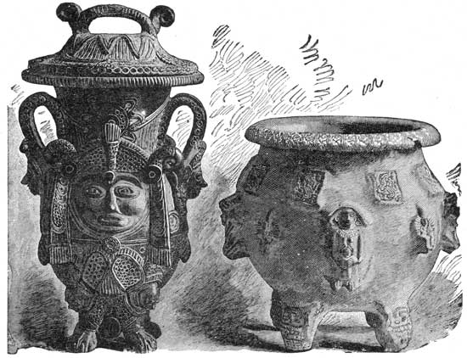
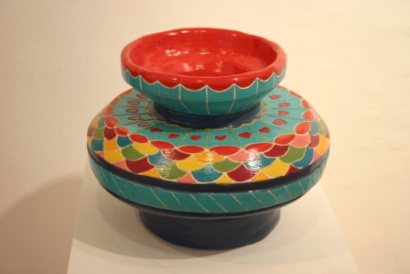
Art and Sculpture

Slide 29
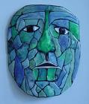
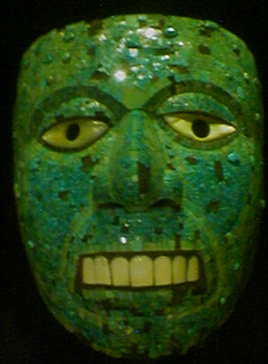
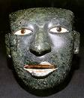
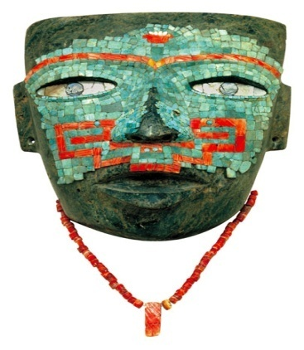
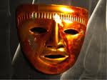
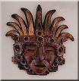
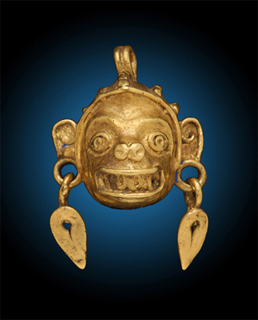
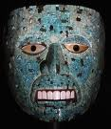
Aztec Masks

Slide 30
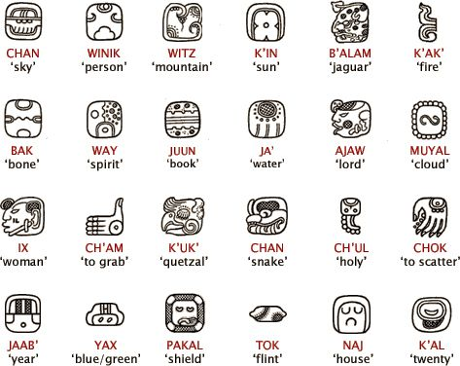

Slide 31
D. P-Politics
Had a king or speaker who controlled all of the Aztec empire
Nobles helped him manage his kingdom by collecting taxes, being judges, ext.

Slide 32
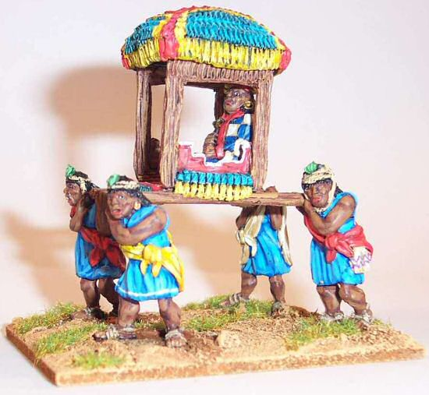
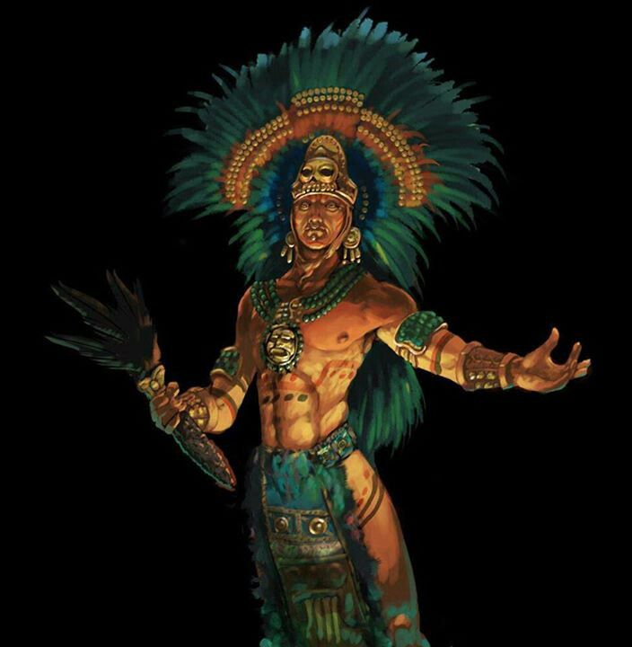

Slide 33
E. E-Economics
Depended on farming
Conquered people to get tribute and sacrifices
Had a huge trade network

Slide 34
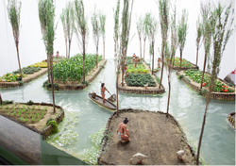
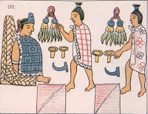

Slide 35
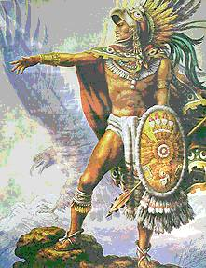
Fierce Fighters
The Aztecs were proud, war faring people.
Aztecs saw war as a duty to the gods.
New born babies were given bows and arrows and children were brought up to fight.
When boys were 18, they took part in their first battle.
Once they had captured their first prisoner, they became a warrior.
The more captives the warriors took, the grander their costumes became.
To celebrate taking their first prisoner, young warriors had their faces smeared with blood from a human sacrifice.

Slide 36
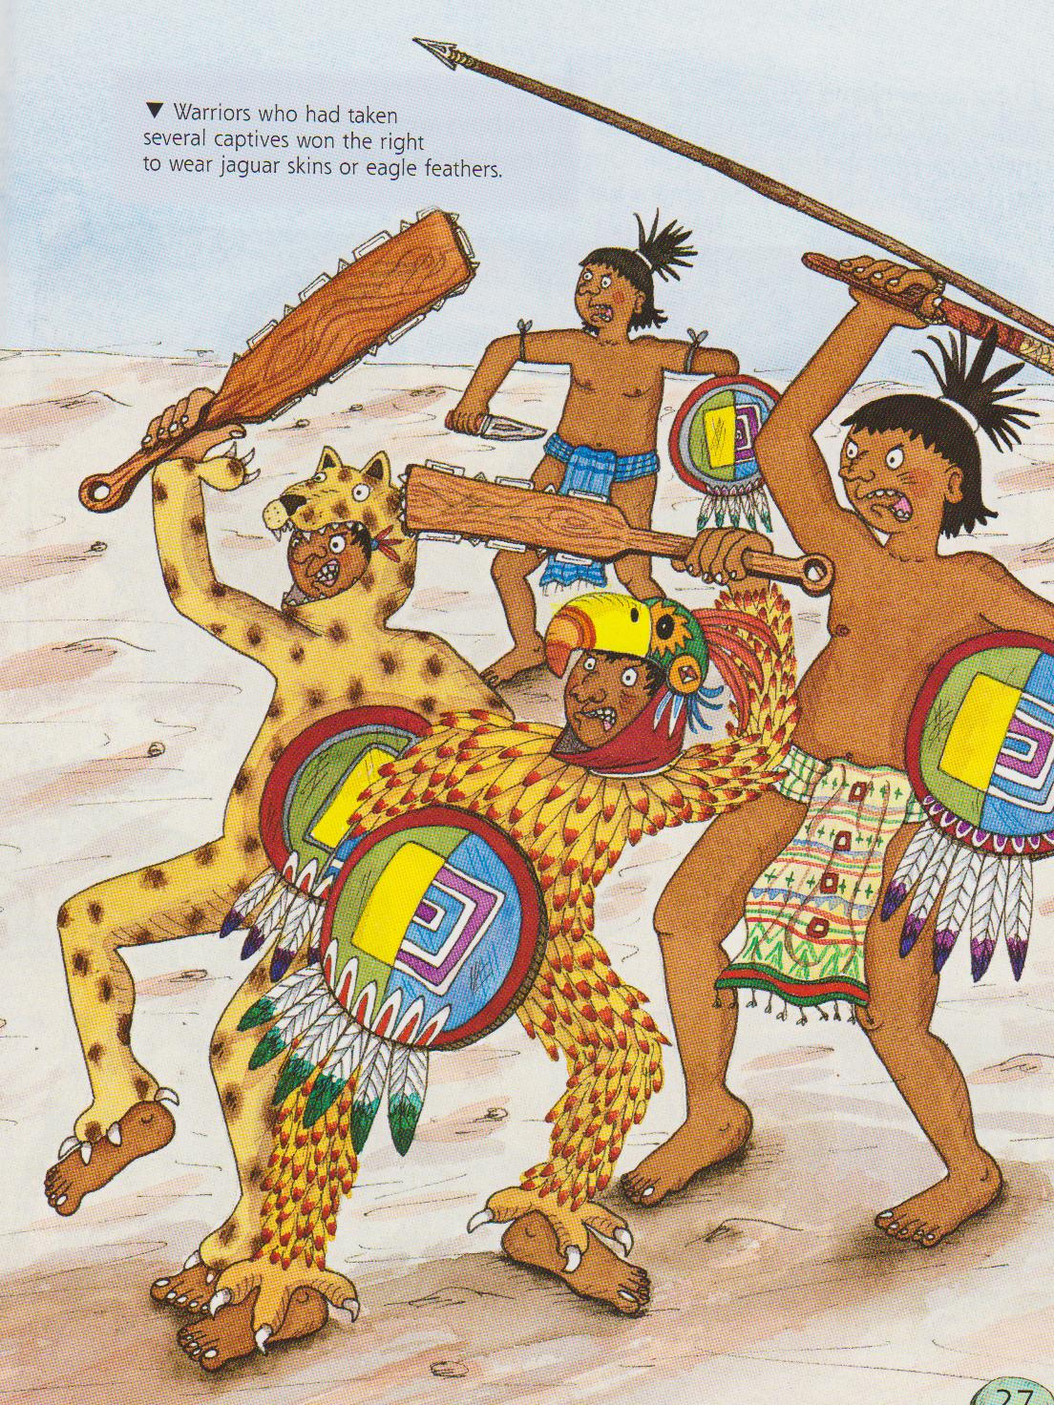
When they heard the war drum, every man in the city got ready to go off to fight.
They attacked enemy towns and took their captives home and then killed them as sacrifices to the gods.
The best warriors were eagle knights and jaguar knights. They wore special clothes.
They fought with knives, spears, arrows, deadly clubs and shields.
The Aztecs thought that brave warriors who died came back to life as hummingbirds and butterflies.

Slide 37
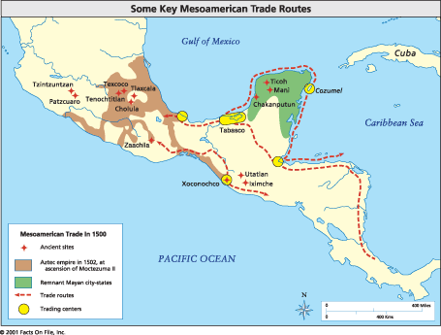

Slide 38
First to drink hot cocoa- put chilies in it to make it spicy
Grew maize, beans, tomatoes, vegetables, and Chile peppers
Also ate dogs, monkeys, lizards, ants, caterpillars, and insects

Slide 40
F. S-Social Structure
Aztec society was divided by social roles and by class
They roles determined how the men and women would live

Slide 41
Kings and nobles
Priests and warriors
Merchants and artisans
Farmers and slaves

Slide 42
Classes of Aztec Society: Kings and Nobles
The king was the most powerful person in Aztec society.
The king was in charge of law, trade and tribute, and warfare.
The king had nobles to help him manage the kingdom.
The nobles were tax collectors and judges as well as other jobs. They passed their titles down from father to son.

Slide 44
Classes of Aztec Society: Warriors and Priests
The priests had a great deal of influence over the lives of the Aztecs.
The priests had many duties, including keeping calendars to decide when to plant crops and hold religious ceremonies.
Aztec warriors also had many duties. They fought to capture victims for religious sacrifices. They also brought great wealth to the empire.
The warriors were very well respected by the Aztecs.

Slide 46
Classes of Aztec Society: Merchants and Artisans
Merchants gathered goods from all over the empire and sold them in the main market.
Many merchants were very wealthy and used their money to build large houses and send their sons to private schools.
Artisans were also rich and important to the Aztecs. They made gold jewelry and elaborate headdresses.

Slide 47
Classes of Aztec Society: Farmers and Slaves
Farmers and slaves made up the lowest class of Aztec society.
Most of the people who lived in the empire were farmers who grew maize, beans, and a few other crops.
Farmers were very poor and did not own their own land.
Slaves were people who had been captured in battle or who could not pay their debts. They were laborers, and if they did not obey, they were sacrificed to the gods.

