Slide 1
Comparative Economic Systems
Do Now: Answer the following question to the best of your ability:
What problem/issue determines how a country needs a system to determine how to use its productive resources?

Slide 2
  Because of the problem of scarcity, every country needs a system to determine how to use its productive resources
  Scarcity = not having enough of something
An economic system must answer 3 questions…

Slide 3
Three Types of Economic Systems:
1. Traditional Economy
2. Command Economy
3. Market Economy
4. * Most countries are… Mixed Economies! (Market + Command)

Slide 4
Economic Systems
On a separate piece of paper, copy the following chart.
TRADITIONAL
COMMAND
MIXED
MARKET
1. WHAT TO PRODUCE? (What kinds of goods and services should be produced?)
2. HOW TO PRODUCE? (What productive resources are used to produce goods and services?)
3. FOR WHOM TO PRODUCE? (Who gets to have the goods and services?

Slide 5
Economic Systems
An economic system describes how a country’s economy is organized
The way in which a nation uses its resources to satisfy its people’s needs and wants

Slide 6
Standards Used to Distinguish Economic Systems
Some standards used to distinguish among economic systems are:
Who owns the resources?
What decision-making process is used to allocate resources and products?
What types of incentives guide economic decision makers?

Slide 7
Traditional Economy
An economic system in which economic decisions are based on customs and beliefs
People will make what they always made & will do the same work their parents did
Exchange of goods is done through Bartering: trading without using money

Slide 8
Traditional Economy
Who decides what to produce?
  People follow their customs and make what their ancestors made
Who decides how to produce goods & services?
  People grow & make things the same way that their ancestors did
Who are the goods & services produced for?
  People in the village who need them

Slide 9
Traditional Economy
Examples:
  Villages in Africa and South America
  the Inuit tribes in Canada
  the caste system in parts of rural India
  the Aborigines in Australia

Slide 10
Traditional System
Traditional economy – system in which economic decisions are based on customs and beliefs that have been handed down from generation to generation
  Trades and work learned from parents
  Know what is expected of you
  Change discouraged or punished
  Production inefficient and choice of goods is rare
  Examples – Eskimos, Aborigines & Amish?

Slide 11
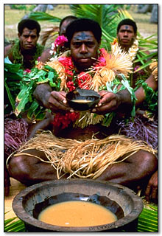
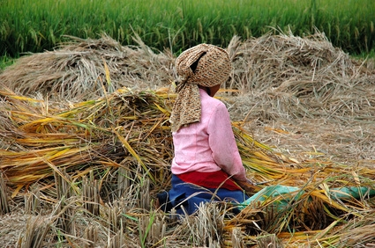
Traditional Economic System: Ritual, Habit, and Custom
The basic economic questions are answered: by doing things the way they have always been done.

Slide 12
Traditional System
Traditional economy – system in which economic decisions are based on customs and beliefs that have been handed down from generation to generation
  Trades and work learned from parents
  Know what is expected of you
  Change discouraged or punished
  Production inefficient and choice of goods is rare
  Examples – Eskimos, Aborigines & Amish?

Slide 13

Traditional Economy
In a traditional economy, goods and services are produced by the family for their personal consumption.
A traditional economy is shaped largely by custom or religion.

Slide 14
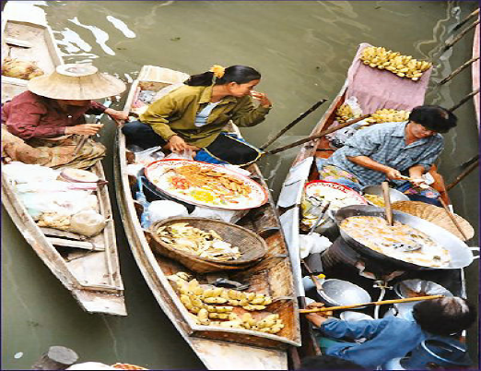
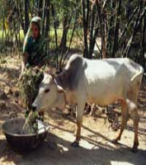
Traditional Economy
In a traditional economy, resources are allocated according to long-lived practices from the past. There is little surplus (something extra) and little trade (or exchange of goods).

Slide 15
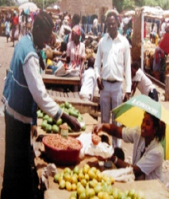
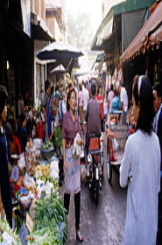
Traditional Economy
In a traditional economy, there is only a limited need for markets (places to buy and sell goods and services).

Slide 16
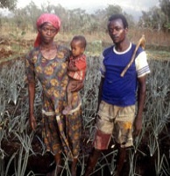
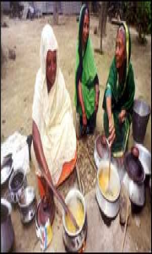
Traditional Economy
A traditional economy is the type of economy found in less developed nations,
usually in rural areas.

Slide 17
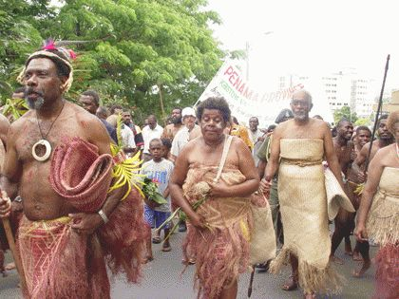
Types of Economic Systems
Traditional Economy
  centers on families, clans, or tribes
    decisions are based on customs and beliefs
  Good of the group always comes before individual desires

Slide 18
Create the following “T” chart
Traditional Economy
Advantages
Disadvantages

Slide 19
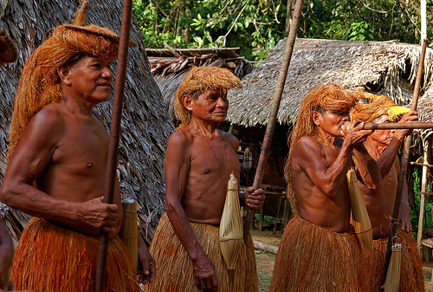
Advantages
Sets forth certain economic roles for all members of the community
Stable, predictable, and continuous life
Revolves around family
Communities stay relatively close and small

Slide 20
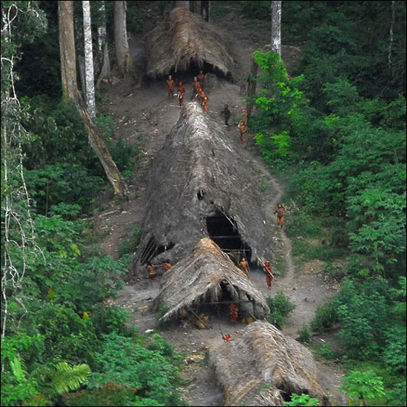
Disadvantages
Discourages new ideas, new technology, and new ways of doing things
Stagnation and lack of progress
Lower standard of living – lack modern conveniences
Have few mechanisms in place to deal with disasters such as floods, drought

Slide 21
Characteristics of Traditional Economies
Advantages and Disadvantages
  Advantages: little disagreement over goals, roles
    methods of production, distribution determined by custom
  Disadvantages: as result of resistance to change, less productive
    do not use new methods; people not in jobs they are best suited for
    low productivity results in low standard of living

