Slide 1
DO NOW: You are going to start your own business. In your notebook or on a piece of notebook paper answer the following: 1. What type of business are you interested in starting? 2. Come up with a name for your business.
An
IDEA !

Slide 2
1
Do you have the skills that your business will need?
(The Beginning)
BUT…
Do you need a higher or specialized education for your business to work?
An
IDEA !
Do you have experience in some aspects of this business?

Slide 3
2
A Year Before Start-Up
Then you could still benefit by speaking to someone in this business with more experience than you.
IF YES…
Then you need to get the skills, experience, and/or education that you will need to succeed in this business OR find a partner who DOES have these attributes.
IF
NO…

Slide 4
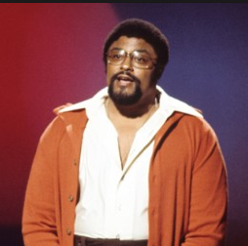
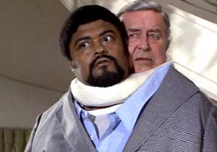
Will your new business be…
3
OR
A Sole
Proprietorship
A Partnership

Slide 5
4
A Year Before Start-Up
Conduct research about your business:
Is there a need for your business or product?
What is the competition like?
Schedule meetings with business professionals such as attorneys, accountants and bankers.
Inquire about licensing and permit requirements for your type of business, tax implications and start-up costs.
One year before start up you should also decide on a business location and visit prospective properties.

Slide 6
5
A Year Before Start-Up
Begin writing a business plan. A business plan is a document that outlines the goals and objectives of your company.
The plan will allow you to fine-tune your business idea and organize a budget. If you need money for your business, any bank or investor will want to view your business plan.

Slide 7
Got Money?
6
Just so ya know….
Have you saved up enough money to start the kind of business you are thinking of?
If not….

Slide 8
6
Do you have any rich relatives or friends who would be willing to lend you the money for your start up costs?
If not…
You are going to have to speak to a bank about a small business loan !

Slide 9
6
Just so ya know….

Slide 10
YAY! YOU SOMEHOW GOT THE MONEY!

Slide 11
7
Nine Months Before Start-Up
Apply for local licenses and permits with the appropriate city and state government.
a general business license from the city
such as liquor or lottery sales, you will need a federal license.
If you want to perform professional services (nursing, daycare, insurance sales, accounting, real estate etc…) you will need an occupational license.

Slide 12
8
You also
might consider these other little things.
Do you know about Website construction and “e-commerce?
Do you know the basics of accounting or how to handle money?
Do you have the skills to use them?
Do you have all the communications, computer and other business tools in place?
Have you successfully test marketed your product or service?

Slide 13
9
If you have everything else figured out, lets get ready to begin.
Will you need employees?
If so how many?
How much will you pay them?

Slide 14
10
Will you provide them with health care insurance?
All businesses with over 50 full-time equivalent (FTE) employees provide health insurance for their full-time employees, or pay a per month “Employer Shared Responsibility Payment” on their federal tax return.

Slide 15
11
What other things do you think you should plan for before opening for business?

Slide 16
12
FIVE YEARS LATER:
Your business has become bigger than you could have ever expected.
You need money to expand in a really big way!
What can you do with your business to get the money to do this?

Slide 22
Minding Your Own Business

Slide 24
Things You Should Know Before Trying to Start a Business

