Slide 1
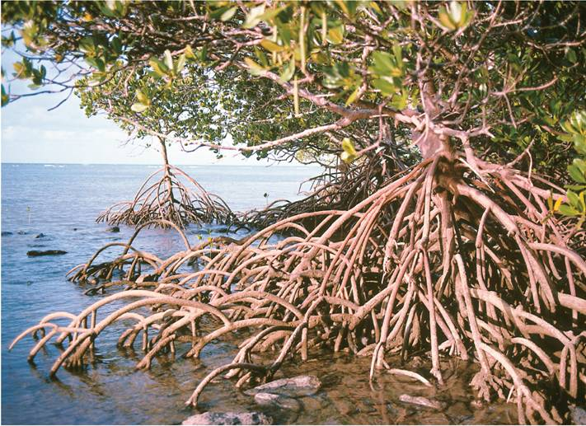
4-5 Aquatic Ecosystems
Notes:
Photo Credit: © Belinda Wright/DRK Photo

Slide 2
4-4 Aquatic Ecosystems
Nearly three-fourths of the Earth’s surface is covered with water.
Almost all bodies of water contain a wide variety of communities governed by biotic and abiotic factors including light, nutrient availability, and oxygen.

Slide 3
4-4 Aquatic Ecosystems
Aquatic ecosystems are determined primarily by the depth, flow, temperature, and chemistry of the overlying water.

Slide 4
4-4 Aquatic Ecosystems
Aquatic ecosystems are often grouped according to the abiotic factors that affect them.
The depth of water determines the amount of light that organisms receive.

Slide 5
4-4 Aquatic Ecosystems
Water chemistry refers to the amount of dissolved chemicals on which life depends.
Communities of organisms found in shallow water close to shore can be very different from the communities that occur away from shore in deep water.
Latitude is an important abiotic factor to both land biomes and aquatic ecosystems.

Slide 6
Freshwater Ecosystems
Freshwater ecosystems can be divided into two main types:
flowing-water ecosystems
standing-water ecosystems

Slide 7
Flowing-Water Ecosystems
Rivers, streams, creeks, and brooks are freshwater ecosystems that flow over land.
Organisms that live there are well adapted to the rate of flow.

Slide 8
Flowing-water ecosystems originate in mountains or hills.
Turbulent water near the source has little plant life.
As the water flows downhill, sediments build up and enable plants to grow.
Downstream, water may meander slowly, where turtles, beavers, and river otters live.

Slide 9
Freshwater Ecosystems
Standing-Water Ecosystems
Lakes and ponds are standing-water ecosystems.
In addition to the net flow of water in and out of these systems, there is usually water circulating within them.
This circulation helps to distribute heat, oxygen, and nutrients throughout the ecosystem.

Slide 10
Freshwater Ecosystems
Still waters provide habitats for organisms such as plankton.
Plankton is a general term for free-floating organisms that live in both freshwater and saltwater environments.

Slide 11
Freshwater Ecosystems
Unicellular algae, or phytoplankton, are supported by nutrients in the water and form the base of many aquatic food webs.
Zooplankton are unicellular animals that feed on phytoplankton.

Slide 12
Freshwater Ecosystems
Freshwater Wetlands
A wetland is an ecosystem in which water covers the soil or is present at or near the surface of the soil at least part of the year.
The water in wetlands may be flowing or standing and fresh, salty, or brackish.
Many wetlands are productive ecosystems that serve as breeding grounds for many types of wildlife.

Slide 13
Freshwater Ecosystems
The three main types of freshwater wetlands are bogs, marshes, and swamps.
Bogs are wetlands that typically form in depressions where water collects.
Marshes are shallow wetlands along rivers.
In swamps, which often look like flooded forests, water flows slowly.

Slide 14
Estuaries
Estuaries
Estuaries are wetlands formed where rivers meet the sea.
Estuaries contain a mixture of fresh and salt water, and are affected by the ocean tides.

Slide 15
Estuaries
Primary producers include plants, algae, and bacteria.
In estuary food webs, most primary production is not consumed by herbivores. Instead, much of that organic material enters the food web as detritus.
Detritus is made up of tiny pieces of organic material that provide food for organisms at the base of the estuary's food web.

Slide 16
Estuaries
Salt marshes are temperate-zone estuaries dominated by salt-tolerant grasses above the low-tide line, and by seagrasses under water.
Salt marshes occur in estuaries along seacoasts in the temperate zone.

Slide 17
Estuaries
Mangrove swamps are coastal wetlands that occur in bays and estuaries across tropical regions, including southern Florida and Hawaii.
The dominant plants are salt-tolerant trees, called mangroves, with seagrasses common below the low-tide line.

Slide 18
Marine Ecosystems
Marine Ecosystems
The well-lit upper layer of the ocean is known as the photic zone.
Algae and other producers can grow only in this thin surface layer.

Slide 19
Marine Ecosystems
Below the photic zone is the aphotic zone, which is permanently dark.
Chemosynthetic autotrophs are the only producers that can survive in the aphotic zone.

Slide 20
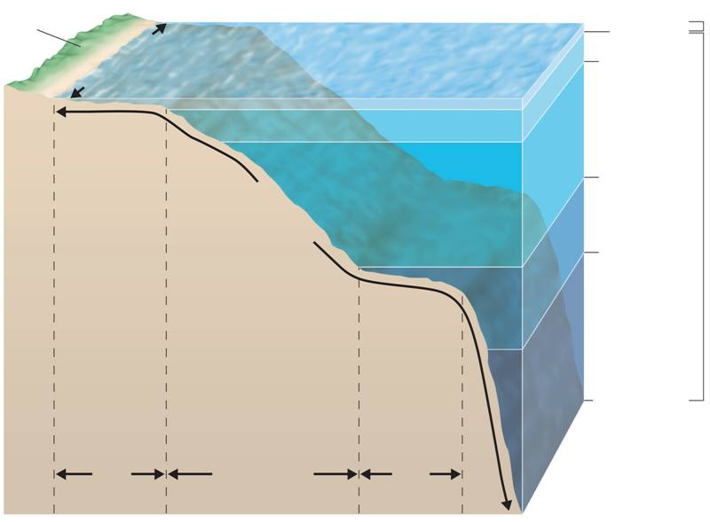
Marine Ecosystems
Photic zone
Land
Intertidal zone
200 m
1,000 m
Coastal
ocean
Open
ocean
4,000 m
Benthic zone
Aphotic zone
6,000 m
Ocean
trench
Continental slope and continental rise
10,000 m
Continental
shelf
Abyssal
plain
Notes:
The ocean can be divided into zones based on light penetration and into zones based on depth and the distance from shore. Each zone contains a characteristic assemblage of organisms.

Slide 21
Marine Ecosystems
Intertidal Zone
Organisms that live in the intertidal zone are exposed to regular and extreme changes in their surroundings.
Competition among organisms in the rocky intertidal zone often leads to zonation, the prominent arrangement of organisms in a particular habitat in horizontal bands.

Slide 22
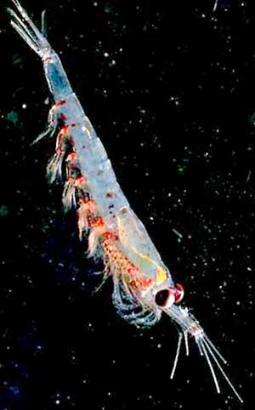
Marine Ecosystems
Coastal Ocean
The coastal ocean extends from the low-tide mark to the outer edge of the continental shelf.
It falls within the photic zone, and photosynthesis occurs throughout its depth.
The coastal ocean is often rich in plankton and many other organisms.

Slide 23
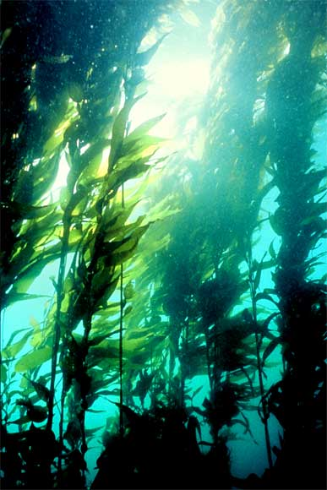
Marine Ecosystems
Kelp forests are named for their dominant organism, a giant brown alga. Kelp forests are one of the most productive coastal ocean communities.
Kelp forests support a complex food web.

Slide 24
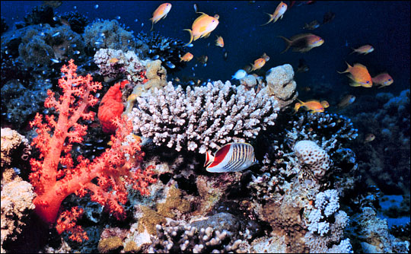
Marine Ecosystems
Coral Reefs
Coral reefs, found in tropical coastal waters, are named for the coral animals whose calcium carbonate skeletons make up their primary structure.

Slide 25
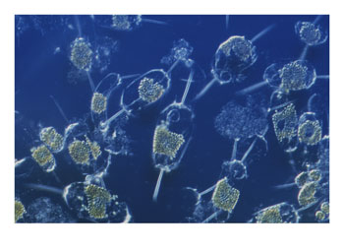
Marine Ecosystems
Open Ocean
The open ocean, the oceanic zone, extends from the edge of the continental shelf outward.
It is the largest marine zone.
Most of the photosynthetic activity on Earth occurs in the photic zone of the open ocean by the smallest producers.

Slide 26
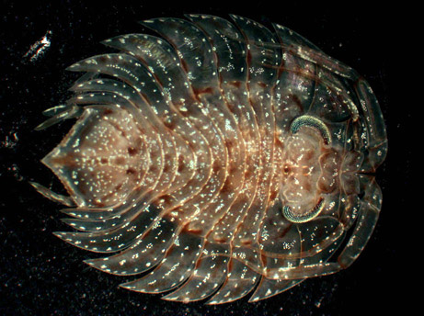
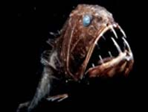
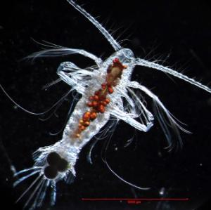
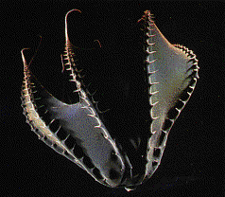
Marine Ecosystems
Benthic Zone
The ocean floor contains organisms that live attached to or near the bottom.
These organisms are called benthos. The ocean floor is called the benthic zone.

