Slide 1
Open House
2017-2018
Mrs. Gullo
Room 2.121

Slide 2
7:15-8:15 Morning Work
8:15-9:30 Math
9:30-9:45 Snack/Restroom break
9:45-11:15 ELA….Reading/Writing Block
11:18-11:48 Lunch
11:50-12:10 Recess
12:10-1:00 Science/S.S./Health
1:00-1:15 Agenda
1:15-2:05 Specials
2:05-2:15 Pack & Stack, Homework
2:15 Dismissal

Slide 3
“The Bridge”
Third graders come as 2nd graders and leave as 4th graders
Personal Responsibility is very important this year. Parents…allow your child to fail and succeed without your rescue.
https://www.youtube.com/watch?v=lEWEB5SkUIc

Slide 4
Classroom rules are simple and clear: listen & follow directions and do your personal best.
When students follow school and classroom rules, complete classwork & homework, and serve as role models for others …… they earn class money! Money will be used at school store.
3rd Grade Store takes place quarterly
Students become entrepreneurs and provide good and services for the “third grade community” while enhancing their math skills. The practice of school store directly ties to our Social Studies curriculum and standards.
Students will create and run their own “business….more info coming in October!

Slide 5
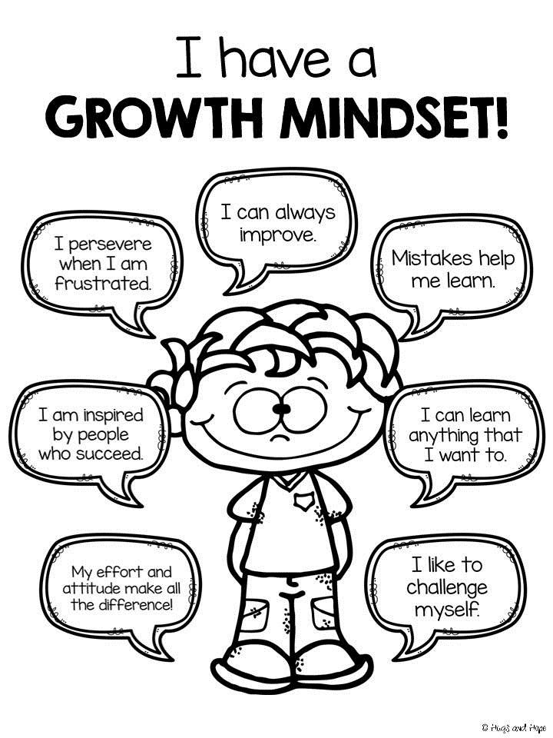
SCHOOL/CLASSROOM THEME:
GROWTH MIND SET
https://www.youtube.com/watch?v=ElVUqv0v1EE

Slide 6
Students copy homework down each day into their agendas.
Homework is also posted on our class website.
http://ginagullo.educatorpages.com/
Homework promotes responsibility, organization, and time management. It also allows parents to see their child’s strengths and weaknesses,
Students will have Reading and Math homework each night. Students will always have a chance to begin it in class. If they use time wisely, most should finish by the end of the day.
30 minute rule ☺
Folders and workbooks hold homework assignments. The journals are used as a resource.

Slide 7
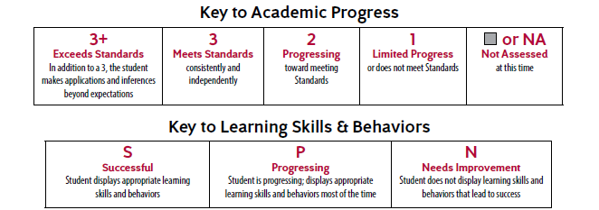
Learning skills and behaviors match the Friday folder check sheet. All graded papers will be sent home in the Friday folder.

Slide 8
Students need to be in the classroom at 7:50…or before the bell rings.
If sick- keep your child at home.
If your child is out- please send an excuse when he/she returns.
If out more than one day- please pick up class work.

Slide 9
This letter went home in the Cobb county folder during Sneak –A-Peak
.

Slide 10
Spelling:
No weekly tests and lists. All spelling will be taught and integrated into writing. Spelling will NOT be taught in isolation.
Grammar:
Taught each week through mini-lessons, morning work and writing

Slide 11
Guided reading
Whole group reading
Whole group mini-lessons
In 3rd grade, we begin to shift from learning HOW to read to learning FROM reading.

Slide 12
Taught daily
Writing Journals
Integrated through Math, Social Studies and Science.
We will learn CURSIVE this year!

Slide 13
Math RAP/Number Talks/Math Journals. We do this daily on our SMARTBoard.
Timed tests….all year
Guided math
Whole group…introduction of standard
Partner Games/Activities
Homework reviews the skills taught each day.
Addition, subtraction, multiplication and division facts need to be memorized by the end of the year!

Slide 16
Enter Text Here

Slide 17
CATO Field Trips
Nana Nature
Tattling Tales
Wellstar Nurse visits
Cobb County Watershed Program
Georgia Power Program

Slide 18
*Third Grade Cognitive Abilities Test CogAT- September 6-8
*Iowa Assessment IOWA- September 11-15 (IOWA AND COGAT SCORES ARE USED TO QUALIFY FOR THE TARGET/GIFTED PROGRAM)
*End of Grade Assessment….Georgia Milestones (formerly CRCT) …starting
April 11-20….only tested in reading, writing (ELA) and math.
*Common Assessments…quarterly
*RI and MI- 3 times a year….August, December, May
*End of Grade Assessment Retest- Reading and Writing only May 17-22
***We are the most assessed grade level in the school***

Slide 19
If your child will be going home any way other than his/her normal means of transportation, send a note in the morning.
Dismissal changes must be in writing and cannot be taken over the phone/email/text unless it is a change for the student to remain at school.
The office is unable to change the mode of transportation over the phone, through email or after 2PM each day.

Slide 20
Because I need to be available to the students and mornings can be hectic, please send a note or an email if you need to communicate in the morning.
I am available most afternoons (with advance notice) and anytime via email.
gina.gullo@cobbk12.org

