Slide 1
7th Grade Life Science
Genetics, Evolution, and Biodiversity

Slide 2
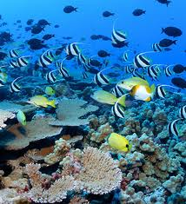
The life on earth now and in the past is extremely diverse.
What we need to know next is…
… how it began,
…has it changed over the years or has it always been here,
…and if it has changed, how and why does it change?

Slide 3
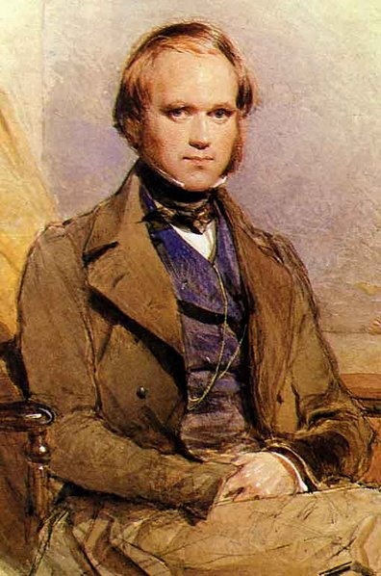
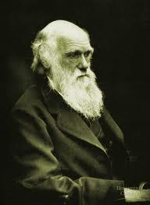
For a long time naturalists worked to describe the life on earth, but they could never explain how they related to each other or how they came to exist.
Modern biology can answer these questions, begins with the work of Charles Darwin, and relies on the concepts of Biological Evolution.
Evolution alone, just refers to change over time, any change.
Biological Evolution refers to a change in allele frequency over time
-basically, changes to the DNA in populations of individuals, which can eventually lead to the development of new species when they have changed enough.

Slide 4
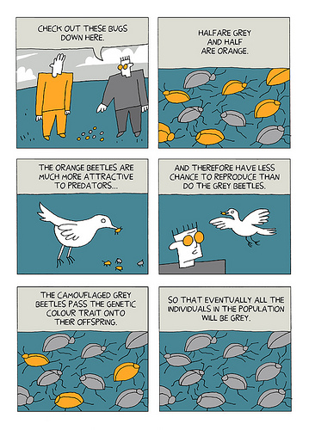
Here’s the basic process:
DNA slightly changes randomly through mutations in every individual, producing variation in the population.
-most mutations either do nothing or are negative, but occasionally they help that individual survive and reproduce (adaptations).
Whatever individuals reproduce the most and produce the most healthy offspring pass on more genes (DNA) than the rest of the population.

Slide 5
3) Some individuals will reproduce more than others by random chance, which can cause allele frequency to fluctuate (genetic drift).
4) However, some individuals will reproduce more than others because their DNA makes them more fit (Natural Selection).
-this genetic variation (different DNA) comes from the positive or negative effects of their mutations and those of their ancestors
-Since they reproduced more, they leave more offspring and more of their genes are in the next generation. The next generation is different than the last generation.

Slide 6
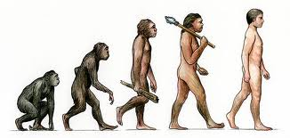
5) These changes occur generation after generation. Eventually, a population can change so much that it becomes a new species.
IT DOES NOT MOVE IN A STRAIGHT LINE!
THERE IS NO LADDER!
Think of it as a bush or tree growing in multiple directions trying to reach sunlight. Some grow for a long time, some don’t.

Slide 7
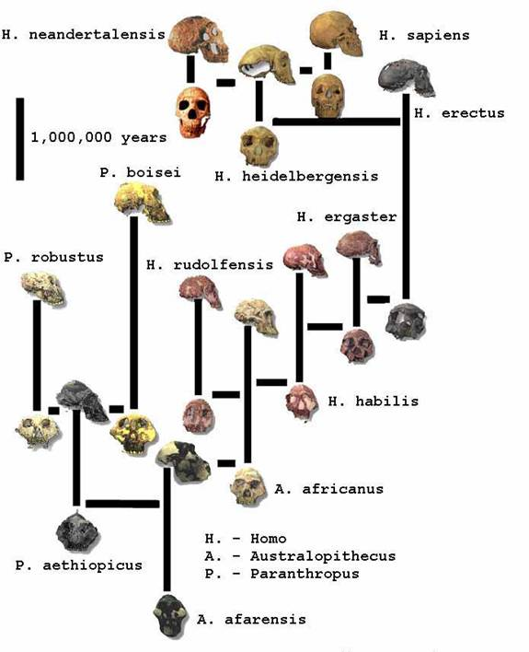
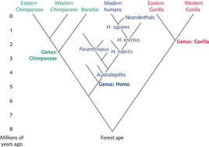

Slide 8
Key Notes:
-Genes mutate randomly. Individuals cannot intentionally do it or decide how they mutate.
-The selection of individuals to survive and reproduce more than others takes place in reaction to the environment. When it changes or a new environment becomes available, which individuals are most fit will also change.
There is no planning by individual organisms or populations.
Things change accidentally, then the best of those accidents stick around through generations because they help individuals survive and reproduce in their current environment.
-if none of the variations of a species are fit to survive an environmental change the species goes extinct, meaning genetic variation is a good thing.
Macro evolution, big evolutionary change, can take a long time depending on the species.

Slide 9
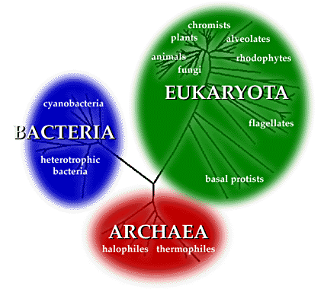
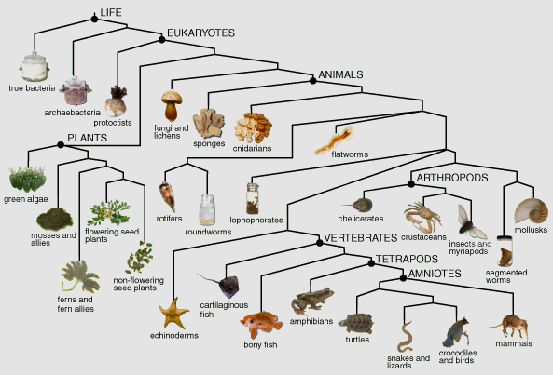
This selection process ALWAYS happens. It NEVER stops.
When you consider how old the earth is (4,600,000,000 years old),
How much the environment has changed over the years,
And that some species have gone extinct opening new environments to other species,
Earth’s biodiversity, the millions of species that have existed in the past and the millions of species alive today, doesn’t seem so unreasonable.

Slide 10
Biology History:
Before Charles Darwin published his book On the Origin of Species, most people looked to The Bible for both historical truth and religious truth.
-now Catholics use it as a way to learn about God and our relationship with God, not to explain how the world works.
His theory of Evolution by Natural Selection started to change that.
-Natural Selection- the individuals most fit to survive and reproduce in their environment produce more offspring than others.
There were other theories before Darwin’s.
Jean-Baptiste Lamarck believed that species could change, but he thought that this would happen during one individual’s life time rather than through generations. According to his theory, organisms would change when the need arose.
All investigations to date, though, have supported Darwin’s theory.

Slide 11
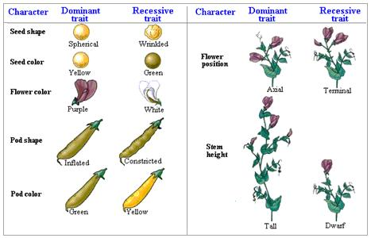
Darwin collected lots of evidence to support his theory, but he didn’t know why offspring resembled their parents, a crucial point to natural selection causing species to change.
Gregor Mendel (a friar and scientist) discovered that units (called genes) were passed from parents to offspring. The combination and interaction of genes from the mother and father decided how the offspring would look and function.
-it was later discovered that these units or genes were segments of large DNA molecules
This fit perfectly and filled-in the largest missing piece to Darwin’s Theory

Slide 12
It would take years for the public to accept Darwin’s theory.
Some still refuse to separate religious and historical truth and maintain the Bible’s Old Testament stories to be literal word for word fact.
As Catholics, we believe that the diversity and complexity of life and its processes, including evolution, provides evidence of God’s wisdom and power.
We don’t view God as a chess player in the sky pushing pieces around, but ultimately God is responsible for all creation.
Pope Pius XII declared that "the teaching authority of the Church does not forbid that, in conformity with the present state of human sciences and sacred theology, research and discussions . . . take place with regard to the doctrine of evolution, in as far as it inquires into the origin of the human body as coming from pre-existent and living matter—[but] the Catholic faith obliges us to hold that souls are immediately created by God" (Pius XII, Humani Generis 36)

Slide 13
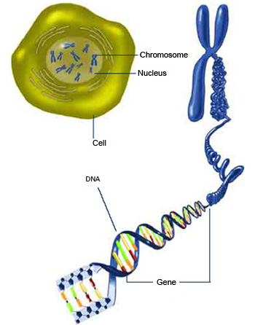
Genetics (an overview)
Every organism has a unique genetic code, chemical information that makes an individual who they are.
This information is stored in large molecules called Deoxyribonucleic Acid (DNA).
Each strand of DNA is basically a long spiraling ladder of smaller molecules.
The order of these smaller molecules makes up the genetic code.
**Every cell in your body has over 6 feet of DNA

Slide 14
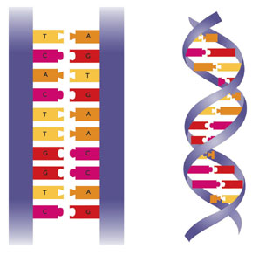
DNA Structure:
A DNA molecule is a chain of smaller molecules called nucleotide bases arranged in pairs to form a twisting ladder called a double helix.
There are four types nucleotide…
-Adenine (purine)
-Guanine (purine)
-Thymine (pyrimidine)
-Cytosine (pyrimidine)
Adenine and Thymine pair together
Guanine and Cytosine pair together
Your genetic information is stored in the order of these pairs.

Slide 15
Through a series of chemical reactions, a cell uses genetic information to make proteins.
What proteins a cell or organism makes, how much they make, and when they make them, make each organism unique, give it its individual traits.
The section of DNA that codes for a particular protein, one trait, is called a gene.
**You have over 30,000 genes
There are different versions of most genes.
The different versions of a gene are called alleles.
-e.g. one gene codes for opsin green, which helps you see red and green. Some alleles of this gene give you normal vision, some others make you color deficient
Evolution has taken place when how common particular alleles are in a population changes.
-e.g. 50% of people in Walpole had blue eyes 20 years ago, but only 30% of people in Walpole have blue eyes now (not actual numbers).

Slide 16
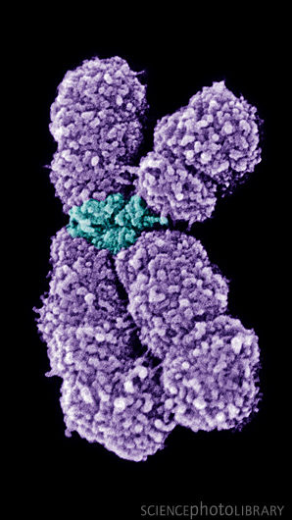
Your DNA isn’t just one molecule. Your DNA is broken into large molecules called chromosomes.
-different species have different numbers.
Chromosome pair
Most organisms (including humans) are diploid, meaning they have two versions of each chromosome.
-one is inherited from the maternal (from mom) and the other is paternal (from dad).
During sexual reproduction, each parent copies their genome (all of their chromosomes) and produces haploid cells (containing one version of each of their chromosomes). A maternal (egg) and paternal haploid cell (sperm) combine to produce a new individual, their offspring.
Humans have 46 total chromosomes, 23 paternal and 23 maternal.
-eggs have 23 and sperm have 23

Slide 17
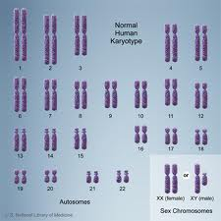
Human chromosomes are numbered 1-22, then x and y.
Everyone has two 1s, two 2s, two 3s, and so on.
Males have one x and one y chromosome.
Women have two x chromosomes.
Replacing the second x for a y is the only genetic difference between men and women.
The DNA molecules are tightly wound together and compacted into chromosomes to save space.

Slide 18
Since you have two of each chromosome, you also have two versions of all your genes, but you usually don’t use both.
Some alleles are dominant and some are recessive.
You could have two dominant, two recessive, or one dominant and one recessive.
If you get one dominant allele and one recessive allele you will only express the dominant allele.
-you could pass it on to your kids, but you don’t show that you have it.
-what you show is called your phenotype

Slide 19
You can predict the chances of having a particular gene by using Punnet Squares.
-place the two alleles from the mother on one side outside of the square
-place the two alleles from the father on the other side of the square
-pull the alleles horizontally from on parent and vertically from the other parent to fill in the inside boxes.
-each box inside is a possible pair of alleles that offspring could have (genotype).
A a
-For one gene, if one parent has two dominant alleles and one parent has one dominant and one recessive, they have a 50% chance of having a child with two dominant alleles and a 50% chance of having one with both types.
-all children would show the dominant allele, though.
AA | Aa
AA | Aa
A
A
In this example: A = dominant allele; a = recessive allele

Slide 20
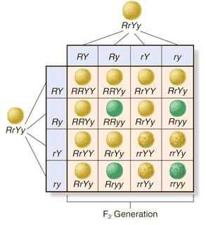
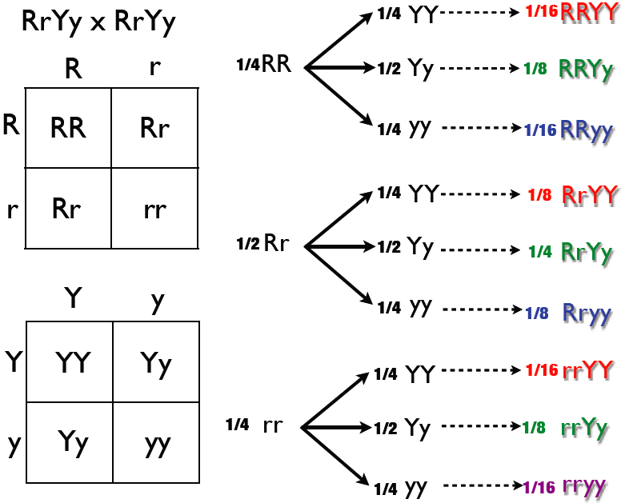
To look at multiple genes at once, you can do what is called a dihybrid cross.
or…
Do multiple monohybrid crosses and then multiply the genotype frequencies to determine the likelihood of multiple events occurring together.
e.g. odds of flipping heads = 50 %...odds of flipping heads twice in a row = 0.5 x 0.5 = 0.25 or 25%
R =round r= wrinkled
Y= yellow y= green

Slide 21
All of your cells constantly undergo two processes to turn genetic information into the molecules they need to function, proteins.
Transcription- Chromosomes are unpacked, base pairs separated, and an mRNA copy of one strand of DNA is made (one gene).
Translation- The mRNA moves out of the nucleus and to ribosome in the cytoplasm or endoplasmic reticulum. The sequence is used there to create specific proteins.
Proteins are the functional parts of cells.
These processes carry us through what is often called the central dogma of biology… DNA to RNA to Protein.

Slide 22
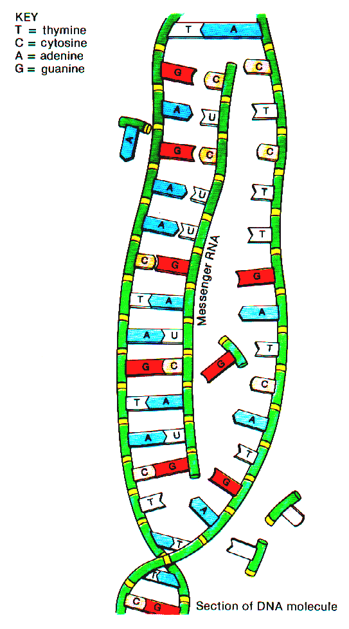
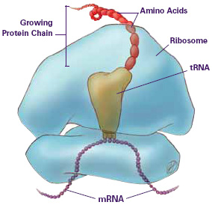
Transcription
Translation

Slide 23
Unit 2: What does your genome do for you?

Slide 24
Unit 3- evolution and biodiversity
Evidence for Evolution:
Vestigial Traits
Analogous structures and homologous structures
Transitional forms
Tracking and observation of microevolution
Genetic analyses

Slide 25
Unit 4: Ecology- Trophism

