Slide 1
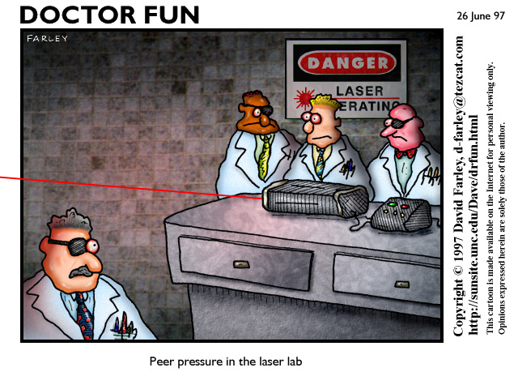
General Safety
Foundations of Engineering and Technology I

Slide 2
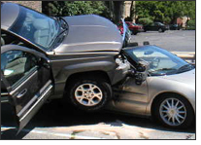
What is an Accident?
An unplanned event that may or may not result in an injury

Slide 3
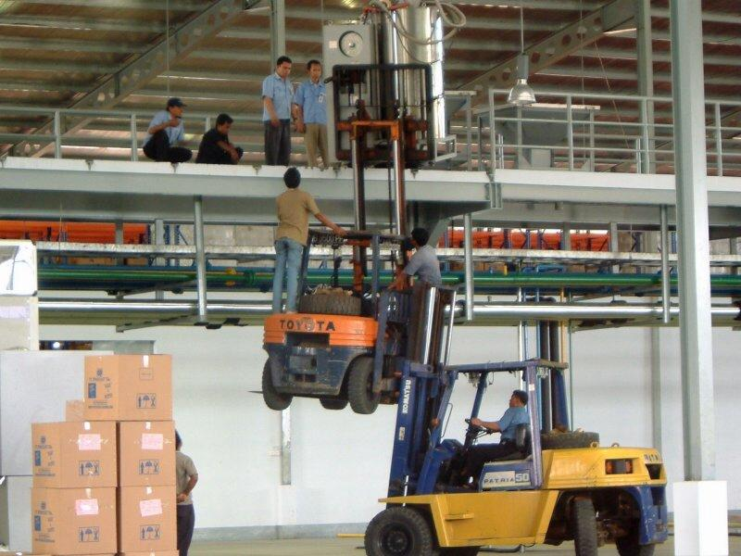
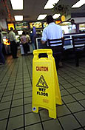
CAUSES OF ACCIDENTS
80% of accidents are caused by human error.
20% of accidents are caused by unsafe conditions in the surroundings.

Slide 4
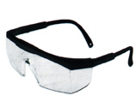
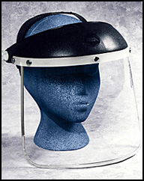
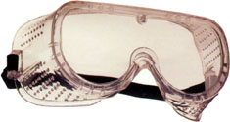
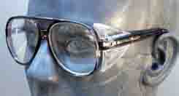
Eye Protection
ALWAYS WEAR EYE PROTECTION WHEN WORKING IN THE LABORATORY!
Safety Glasses
Eye Glass Side Shields
Goggles
Full Face Shields

Slide 5
Tools
Always inspect a tool before you use it.
If there is a damaged switch or cord on a power tool report it to your teacher immediately so that the tool can be put up for repair.
Never touch a power tool if it is moving, wait until it comes to a complete stop.
Always use the tool for it’s proper function.

Slide 6
Using Power Tools in the Laboratory
Always get permission from the teacher before you use the machinery.
Never talk to another student or the instructor while he/she is operating the machinery.
When using the machinery stand only in the “Operator Zone” or the area where only the machinery operator should stand.
Always unplug a power tool by the plug not the cord.

Slide 7
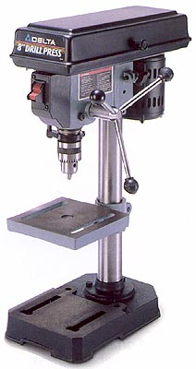
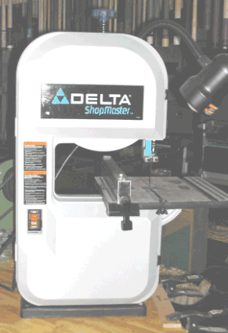
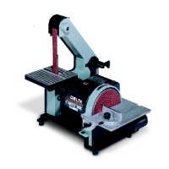
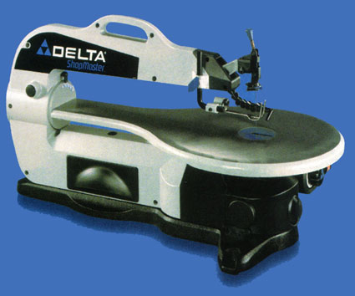
Types of Machines
Drill Press – When cutting holes make sure the material is secured in a Vise or Gripping Tool. Never hold the material.
Band Saw – Use the guide to push material through the blade and keep your hands from the blade. Never force material, forcing means you are trying too hard and could bind.
Scroll Saw – Move material slowly, keep your hand away from the blade.
Sander – Hold material firmly, always move against the spin.

Slide 8
When in the Laboratory…
The Laboratory is a dangerous place if you are not careful.
Never Horse Play.
Never Operate the machinery without checking with the teacher.
Loose hair should be tied up, clothing tucked in, jewelry taken off, and long sleeves rolled up.
If an accident should happen contact the teacher immediately.

Slide 9
Materials
Paint, enamel, lacquer, or solvents must not be used near flames or sparks because they are flammable.
Keep flammable materials in the metal cabinet.
Never leave material lying around someone could get cut, slip, or fall.
Hot metal placed in water can cause the water to be hot enough to burn someone.

Slide 10
Clean Up
ALWAYS CLEAN UP THE LABORATORY BEFORE YOU LEAVE!!!!

