Slide 1
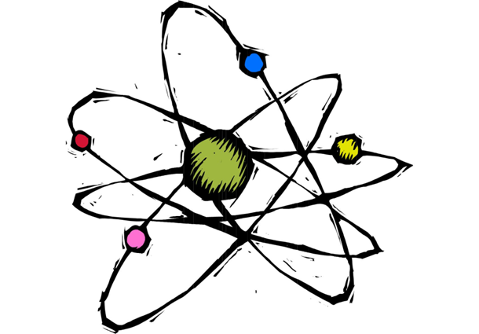
Engage
Symphony of Science: What our World is Made of?

Slide 2
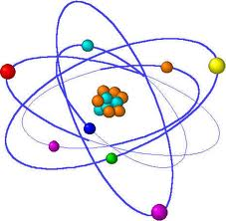
Atoms and the Atomic Theory

Slide 3
Atoms
Remember that matter is anything that takes up space and has mass. All matter is made of atoms.
Atoms are the smallest particle into which an element can be divided and still be the same substance.

Slide 4
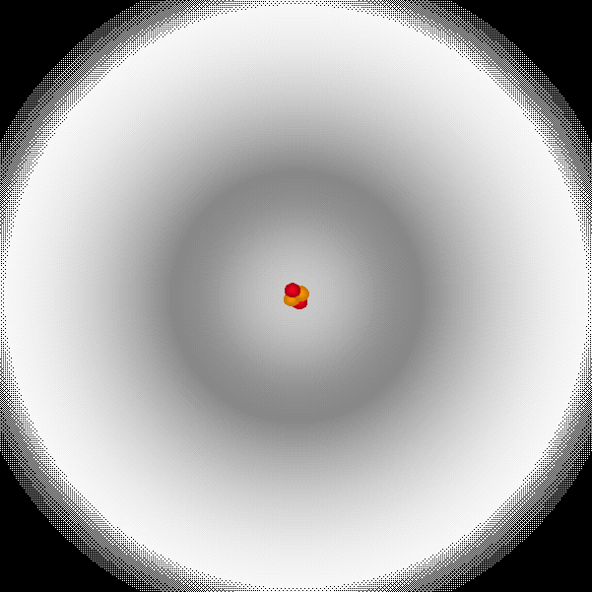
Atomic Structure
There are two basic parts in every atom:
Electron Cloud
or Shell
Nucleus

Slide 5
Parts of an ATOM
 | Charge | Location
Proton | Positive (+) | Nucleus or “Core”
Neutron | No Charge or neutral (0) | Nucleus or “Core”
Electron | Negative (-) | Electron Cloud

Slide 6
Subatomic Particles
Electron Cloud:
Electrons orbit the nucleus.
Nucleus or “Core”:
Protons and Neutrons are found in the nucleus.

Slide 7
Atomic Theory
Because we can not see atoms, we use models to teach and learn about atoms.
The atomic theory has changed over time as new technologies have become available.
Remember: Scientific knowledge builds on past research and experimentation.

Slide 8
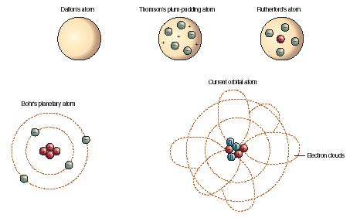
Atomic Theory
Changes over time…

Slide 9
Basic Parts of Atoms
https://www.youtube.com/watch?v=o-3I1JGW-Ck
To Recap what you just learned…..

